Slide 1

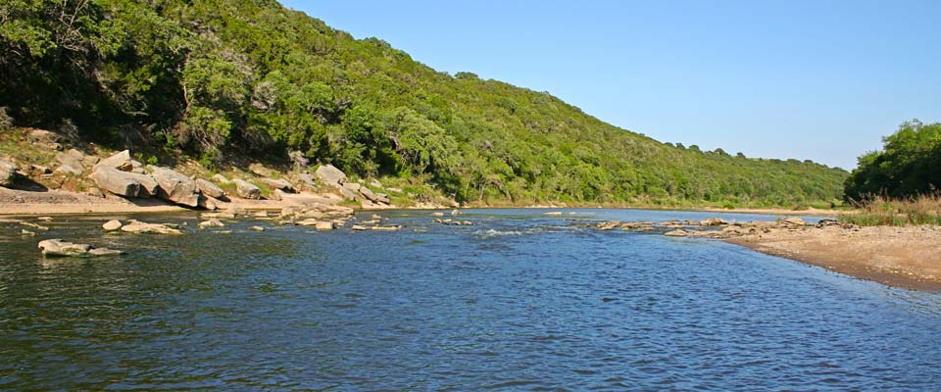
Vernie ‘Cal’ Marshall III, Waco, TX
254.447.0984
Farm & Land
Keller Williams
Farm & Ranch
(254) 447-0984
www.centexlandrealty.com

Slide 2

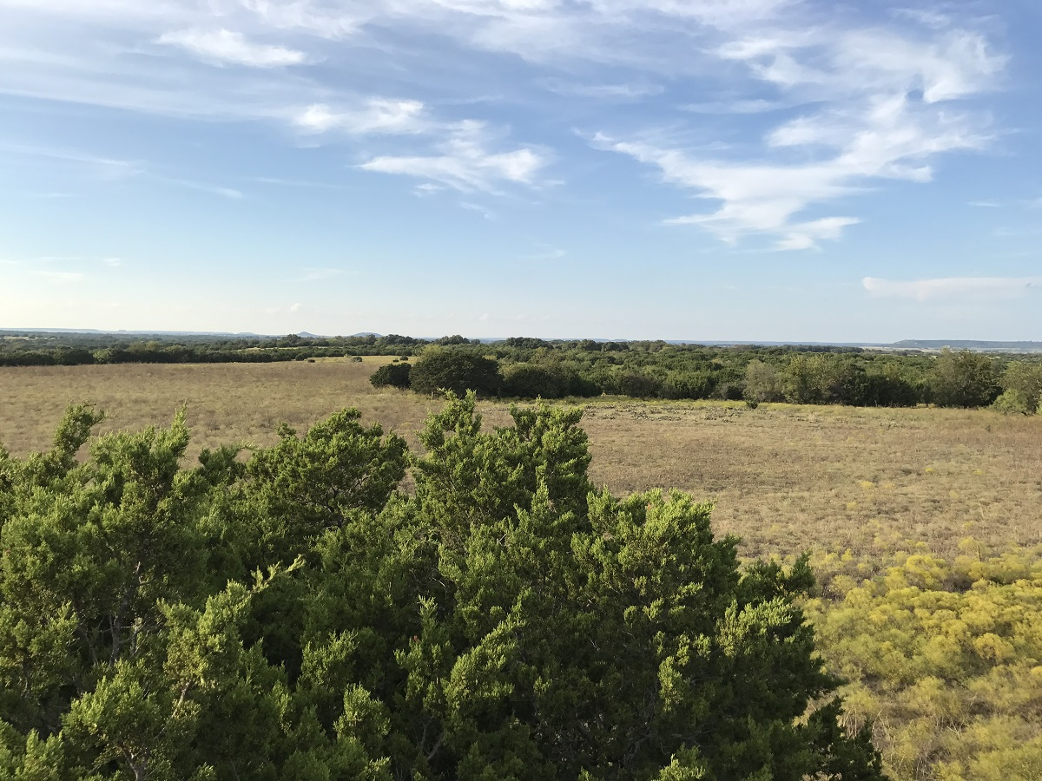
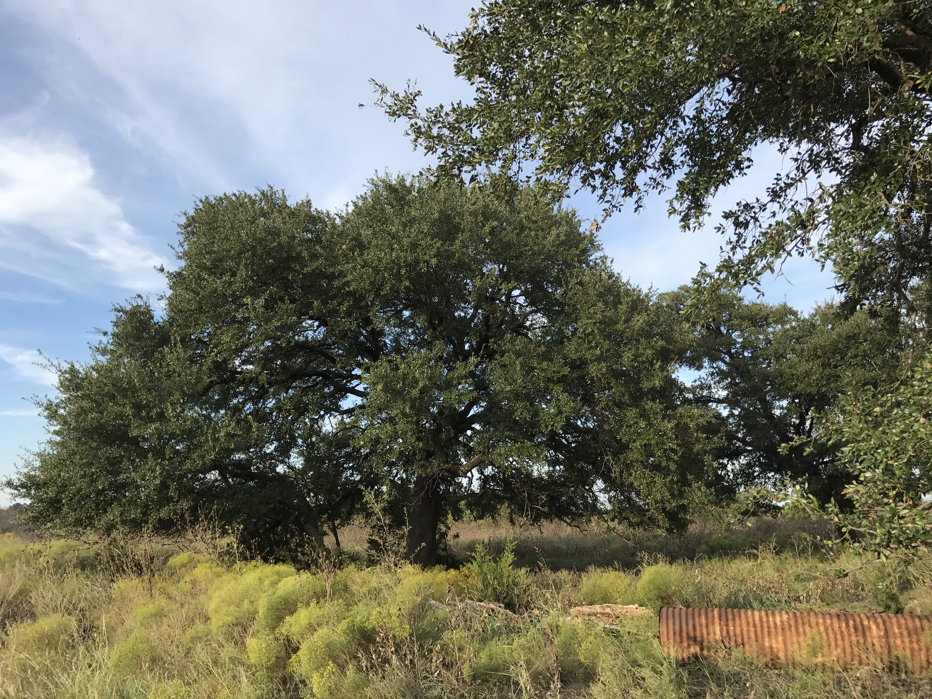
FOR SALE - approximately 98 acres of prime hunting land. Exact acreage will be determined by survey.
This property is located North of Meridian on a well maintained county road. This tract is located in prime hunting country which consist of a good mix of trees. These hardwoods include oaks, hackberry, cedar, and mesquite.
It is crossed fenced into 4 pastures. The SW pasture is mostly in cedar with the other 3 pasture being open. This property is roughly 30% in coverage to 70% open.
$365,000
Vernie”Cal” Marshall III
Land Agent
Cell: (254) 447-0984
www.centexlandrealty.com
The information contained herein was obtained from sources believed reliable; however KW Farm and Ranch Group make no guarantees, warranties, or representations as to the completeness or accurateness thereof. The information submitted is subject to errors, omissions, changes of price or conditions; prior to sale or lease, or withdraw without notice. Any projections, assumptions, or estimates are for illustrative purposes only. Recipients should conduct their own investigation.

Slide 3

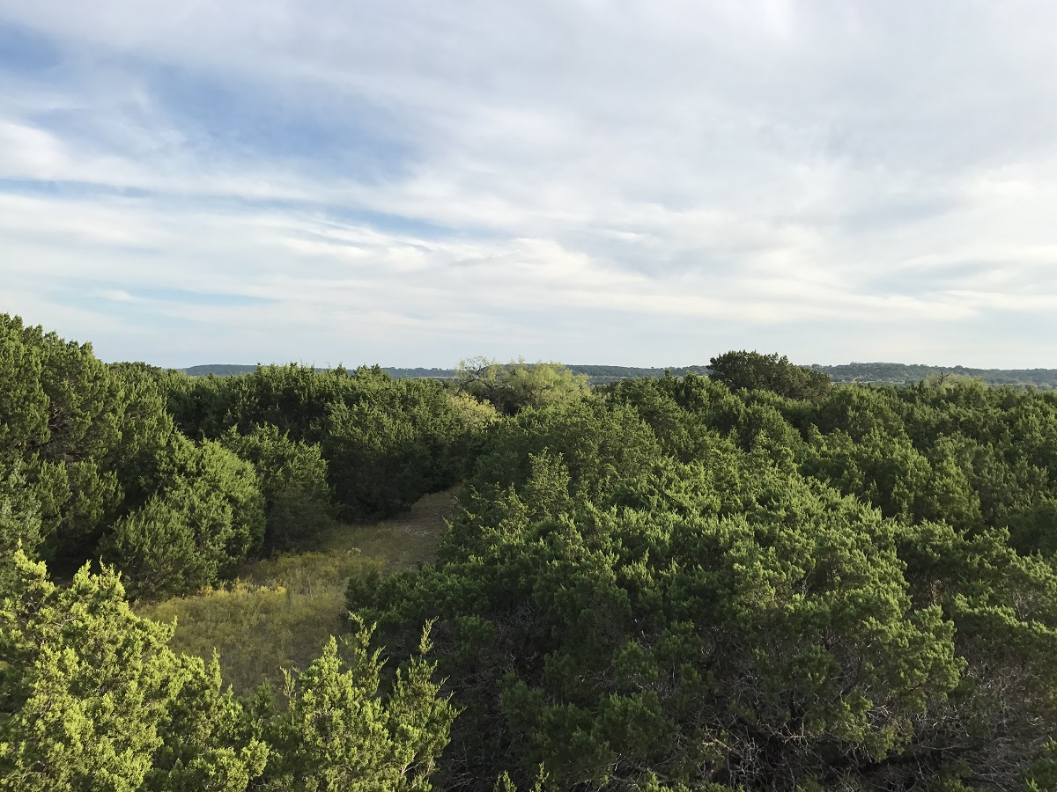
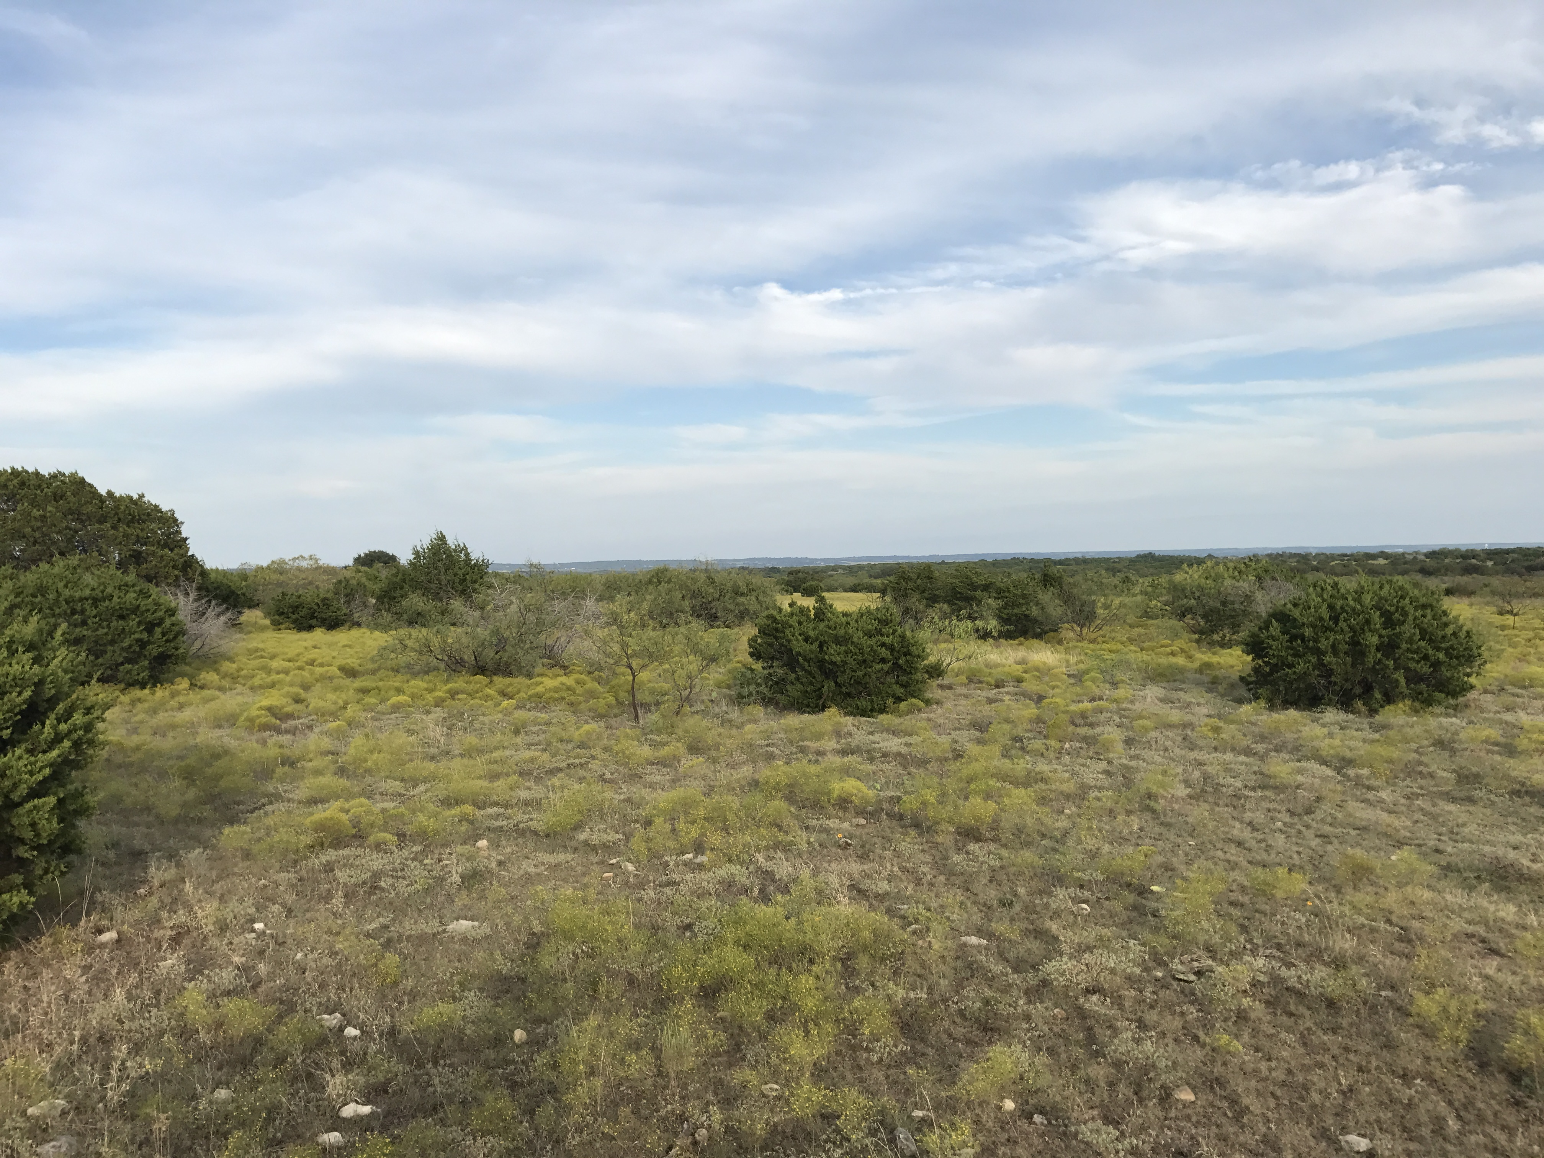
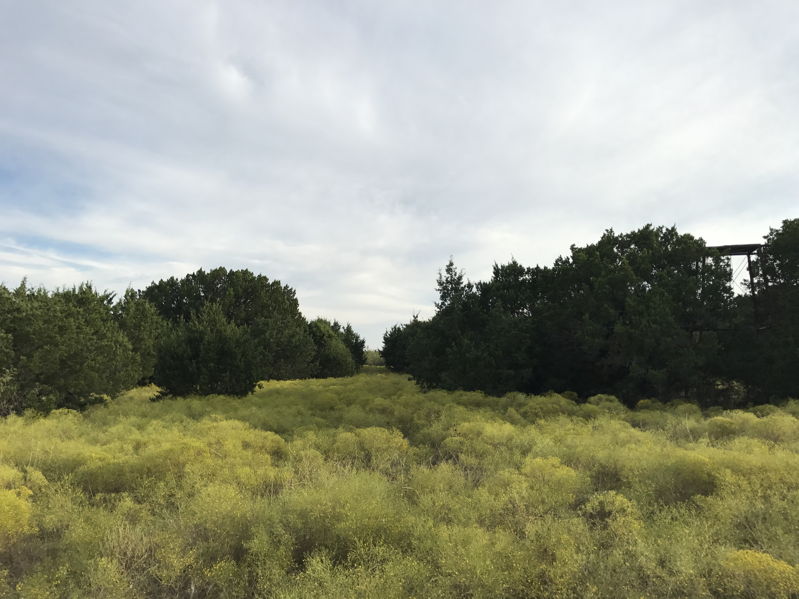
Local Expertise…International Reach!
Technology Based, Internet Driven! - For Complete Information, Please Visit:
Vernie “Cal” Marshall III
Land Agent
Cell: (254) 447-0984
www.centexlandrealty.com
Photos
Vernie “Cal” Marshall III
Land Agent
Cell : (254) 447-0984
www.centexlandrealty.com
The information contained herein was obtained from sources believed reliable; however KW Farm and Ranch Group make no guarantees, warranties, or representations as to the completeness or accurateness thereof. The information submitted is subject to errors, omissions, changes of price or conditions; prior to sale or lease, or withdraw without notice. Any projections, assumptions, or estimates are for illustrative purposes only. Recipients should conduct their own investigation.
The information contained herein was obtained from sources believed reliable; however KW Farm and Ranch Group make no guarantees, warranties, or representations as to the completeness or accurateness thereof. The information submitted is subject to errors, omissions, changes of price or conditions; prior to sale or lease, or withdraw without notice. Any projections, assumptions, or estimates are for illustrative purposes only. Recipients should conduct their own investigation.

Slide 4

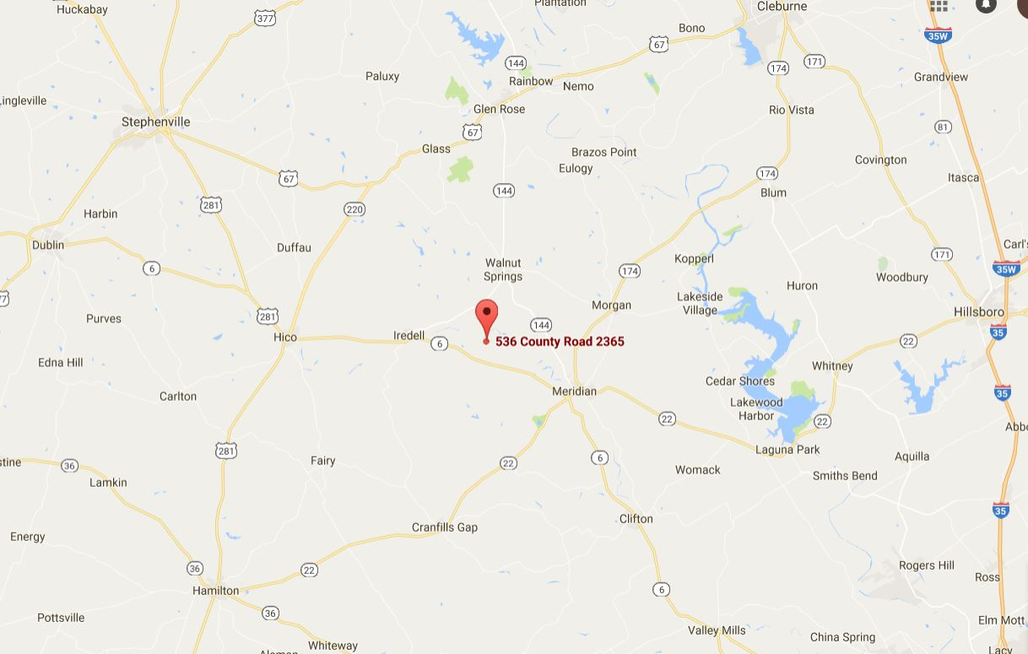
Local Expertise…International Reach!
State
City
Local
Location Maps
Vernie “Cal” Marshall III
Land Agent
Cell: (254) 447-0984
www.centexlandrealty.com
The information contained herein was obtained from sources believed reliable; however KW Farm and Ranch Group make no guarantees, warranties, or representations as to the completeness or accurateness thereof. The information submitted is subject to errors, omissions, changes of price or conditions; prior to sale or lease, or withdraw without notice. Any projections, assumptions, or estimates are for illustrative purposes only. Recipients should conduct their own investigation.

Slide 5

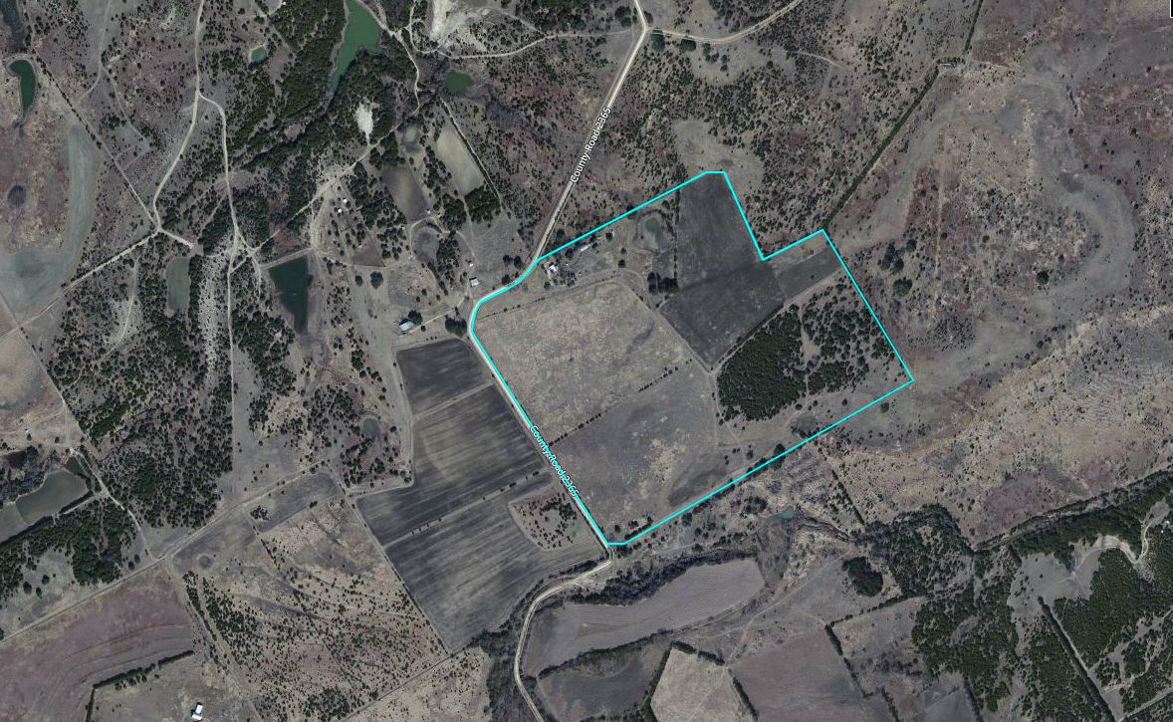
Community Commercial
District
Aerial
Vernie “Cal” Marshall III
Land Agent
Cell: (254) 447-0984
www.centexlandrealty.com
The information contained herein was obtained from sources believed reliable; however KW Farm and Ranch Group make no guarantees, warranties, or representations as to the completeness or accurateness thereof. The information submitted is subject to errors, omissions, changes of price or conditions; prior to sale or lease, or withdraw without notice. Any projections, assumptions, or estimates are for illustrative purposes only. Recipients should conduct their own investigation.

Slide 6
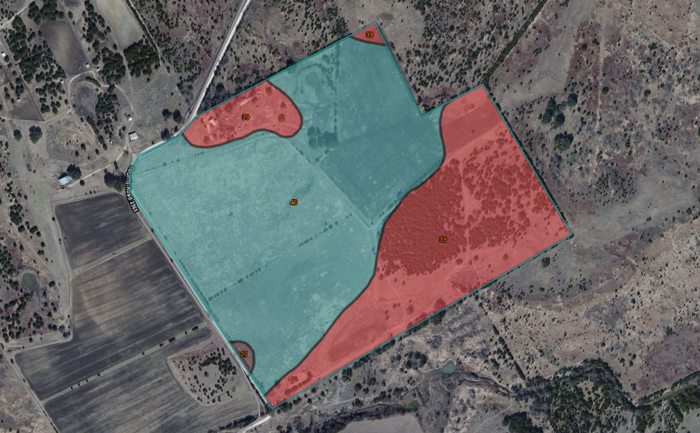
Community Commercial
District
Ecological Maps
Vernie “Cal” Marshall III
Land Agent
Cell: (254) 447-0984
www.centexlandrealty.com
The information contained herein was obtained from sources believed reliable; however KW Farm and Ranch Group make no guarantees, warranties, or representations as to the completeness or accurateness thereof. The information submitted is subject to errors, omissions, changes of price or conditions; prior to sale or lease, or withdraw without notice. Any projections, assumptions, or estimates are for illustrative purposes only. Recipients should conduct their own investigation.

Slide 7

Information
https://youtu.be/HyGpBQFBlis
Video
Vernie “Cal” Marshall III
Land Agent
Cell: (254) 447-0984
www.centexlandrealty.com
The information contained herein was obtained from sources believed reliable; however KW Farm and Ranch Group make no guarantees, warranties, or representations as to the completeness or accurateness thereof. The information submitted is subject to errors, omissions, changes of price or conditions; prior to sale or lease, or withdraw without notice. Any projections, assumptions, or estimates are for illustrative purposes only. Recipients should conduct their own investigation.

Slide 8
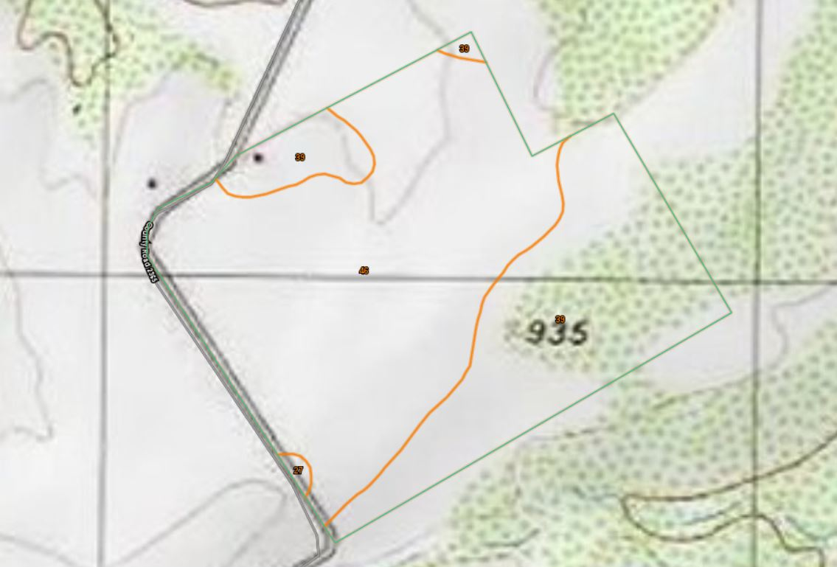
Local Expertise…International Reach!
Information
Topography
Vernie “Cal” Marshall III
Land Agent
Cell: (254) 447-0984
www.centeclandrealty.com
The information contained herein was obtained from sources believed reliable; however KW Farm and Ranch Group make no guarantees, warranties, or representations as to the completeness or accurateness thereof. The information submitted is subject to errors, omissions, changes of price or conditions; prior to sale or lease, or withdraw without notice. Any projections, assumptions, or estimates are for illustrative purposes only. Recipients should conduct their own investigation.

Slide 9
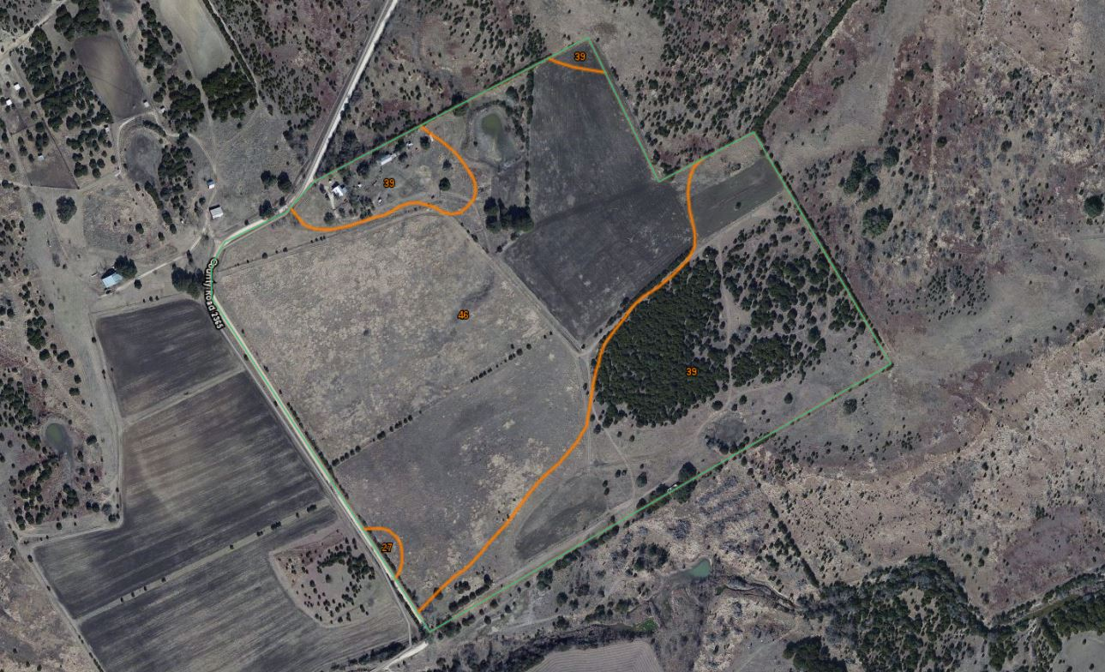
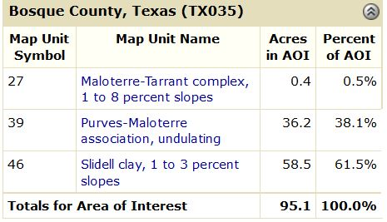
Local Expertise…International Reach!
*
* Approximate acreage taken from soil report. Total acreage is 82.33 acres according to tax records.
Soil Report
Vernie “Cal” Marshall III
Land Agent
Cell: (254) 447-0984
www.centexlandrealty.com
The information contained herein was obtained from sources believed reliable; however KW Farm and Ranch Group make no guarantees, warranties, or representations as to the completeness or accurateness thereof. The information submitted is subject to errors, omissions, changes of price or conditions; prior to sale or lease, or withdraw without notice. Any projections, assumptions, or estimates are for illustrative purposes only. Recipients should conduct their own investigation.

Slide 10
Financing Breakdown
Address – 536 CR 2365
City, State Zip – Meridian, Tx. 76665
Sales Price---------------------------------------------------------------$365,000
Less 15% - Cash Down--------------------------------------------------$54,750
Amount Financed------------------------------------------------------$310,250
__________________________________________________________
Principal & Interest (Monthly)-----------------------------------------$1,849.40
(At 4.5%, 30 year fixed)
Property Taxes (Monthly)-------------------------------------------------$33.33
(Annual payment of $400.00)
Property Insurance (Monthly)--------------------------------------------$125.00
(Annual payment of $1,500.00)
Totally Monthly Payment--------------------------------$2,007.73
Local Expertise…International Reach!
Financing
Breakdown
Vernie “Cal” Marshall III
Land Agent
Cell: (254) 447-0984
www.centexlandrealty.com
The information contained herein was obtained from sources believed reliable; however KW Farm and Ranch Group make no guarantees, warranties, or representations as to the completeness or accurateness thereof. The information submitted is subject to errors, omissions, changes of price or conditions; prior to sale or lease, or withdraw without notice. Any projections, assumptions, or estimates are for illustrative purposes only. Recipients should conduct their own investigation.

Slide 11

Information About Brokerage Services
Before working with a real estate broker, you should know that the duties of a broker depend on whom the broker represents. If you are a prospective seller or landlord (owner) or a prospective buyer or tenant (buyer), you should know that the broker who lists the property for sale or lease is the owner’s agent. A broker who acts as a subagent represents the owner in cooperation with the listing broker. A broker who acts as a buyer’s agent represents the buyer. A broker may act as an intermediary between the parties if the parties consent in writing. A broker can assist you in locating a property, preparing a contract or lease, or obtaining financing without representing you. A broker is obligated by law to treat you honestly.
IF THE BROKER REPRESENTS THE OWNER:
The broker becomes the owner’s agent by entering into an agreement with the owner, usually through a written listing, or by agreeing to act as a subagent by accepting an offer of subagency from the listing broker. A subagent may work in a different real estate office. A listing broker or subagent can assist the buyer but does not represent the buyer and must place the interests of the owner first. The buyer should not tell the owner’s agent anything the buyer would not want the owner to know because an owner’s agent must disclose to the owner any material information known to the agent.
IF THE BROKER REPRESENTS THE BUYER:
The broker becomes the buyer’s agent by entering into an agreement to represent the buyer, usually through a written buyer representation agreement. A buyer’s agent can assist the owner but does not represent the owner and must place the interests of the buyer first. The owner should not tell a buyer’s agent anything the owner would not want the buyer to know because a buyer’s agent must disclose to the buyer any material information known to the agent.
IF THE BROKER ACTS AS AN INTERMEDIARY:
A broker may act as an intermediary between the parties if the broker complies with The Texas Real Estate License Act. The broker must obtain the written consent of each party to the transaction to act as an intermediary. The written consent must state who will pay the broker and, in conspicuous bold or underlined print, set forth the broker’s
obligations as an intermediary. The
broker is required to treat each party honestly and fairly and to comply with the Texas Real Estate License Act. A broker who acts as an intermediary in a transaction:
  Shall treat all parties honestly;
  may not disclose that the owner will accept a price less than the asking price unless authorized in writing to do so by the owner;
  may not disclose that the buyer will pay a price greater than the price submitted in a written offer unless authorized in writing to do so by the buyer;
  may not disclose any confidential information or any information that a party specifically instructs the broker in writing not to disclose unless authorized in writing to disclose the information or required to do so by The Texas Real Estate License Act or a court order or if the information materially relates to the condition of the property.
With the parties’ consent, a broker acting as an intermediary between the parties may appoint a person who is licensed under The Texas Real Estate License Act and associated with the broker to communicate with and carry out instructions of one party and another person who is licensed under that Act and associated with the broker to communicate with and carry out instructions of the other party.
If you choose to have a broker represent you, you should enter into a written agreement with the broker that clearly establishes the broker’s obligations and your obligations. The agreement should state how and by whom the broker will be paid. You have the right to choose the type of representation, if any, you wish to receive. Your payment of a fee to a broker does not necessarily establish that the broker represents you. If you have any questions regarding the duties and responsibilities of the broker, you should resolve those questions before proceeding.
Local Expertise…International Reach!
Real estate licensee asks that you acknowledge receipt of this information about brokerage services for the licensee’s records.
___________________________________________________________________________________________________________
Buyer, seller, landlord, or tenant Date
___________________________________________________________________________________________________________
Buyer, seller, landlord, or tenant Date
Information About
Brokerage Services
Vernie “Cal” Marshall III
Land Agent
Cell: (254) 447-094
www.centexlandrealty.com
The information contained herein was obtained from sources believed reliable; however KW Farm and Ranch Group make no guarantees, warranties, or representations as to the completeness or accurateness thereof. The information submitted is subject to errors, omissions, changes of price or conditions; prior to sale or lease, or withdraw without notice. Any projections, assumptions, or estimates are for illustrative purposes only. Recipients should conduct their own investigation.

