Slide 1
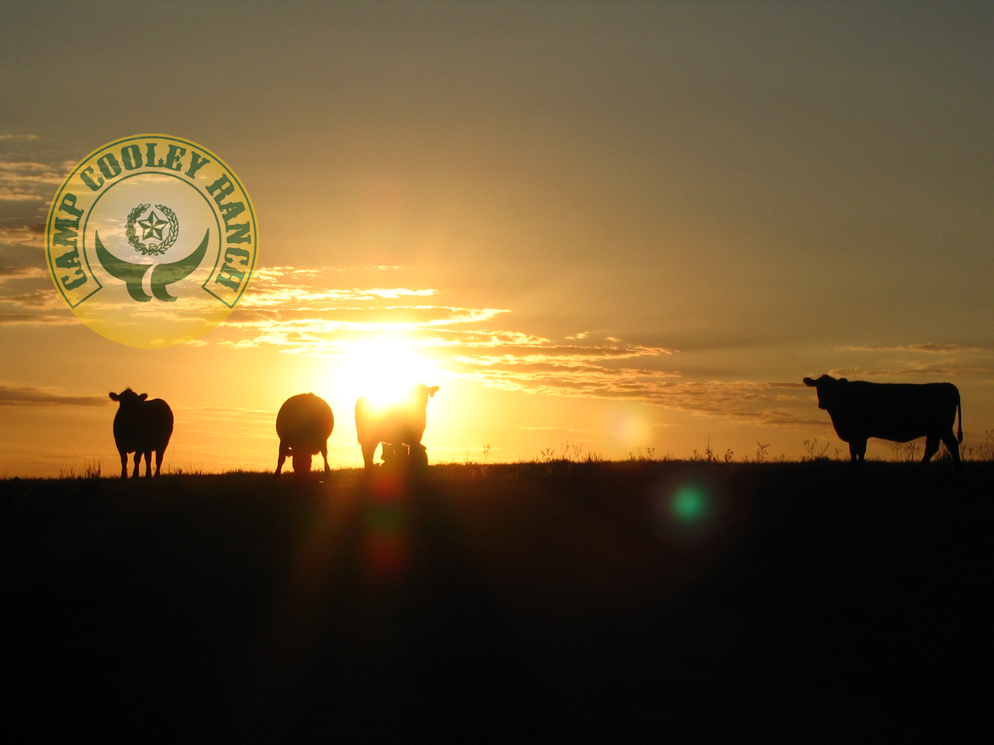
Camp Cooley Ranch
Franklin, Texas

Slide 2
A 21st Century Cattle Ranch
Premier, highly improved ranch
Sophisticated operation and turnkey opportunity.
10,600 (+/-) acres
Multi-dimensional and Multi-functional asset.
Modern Cattle Industry Icon
Developed IP/ Strong Brand Value / Customer Base
Largest contiguous ranch in Central Texas.
Oldest Operating Exotic Game Preserve in Texas.
Character, History, Legacy.

Slide 3
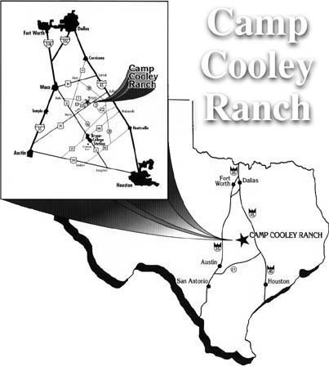
Location
Golden Triangle
Dallas 2.5 hrs
Houston 2.15 hrs
College Station .45 min
(Texas A&M University)
Austin. 1.5 hrs
San Antonio 3.5 hrs

Slide 4
Current Operations & Revenues
Minerals - $1.4 M
Grazing Lease Mgmt - $720 K
Commercial Hay Operations
2010 - $900 K
2011 - $1.5 M
E- Mitigation Bank - $22.5 M
Phase one (Commences 2012)
Hunting $100 K **

Slide 5
Camp Cooley History
The Wheeler Era
Originally began with Bert and Mae Dean Wheeler an Influential Family of the 1940’s
Liquor Store Owner & Legend from Houston
Assembled from approx. 40 tracts (+/-)
Started the Exotics incl. elephants and monkeys.
A getaway & preserve for friends & political figures
Famous Names - LBJ, Sen. J Connolly, Sen. Charles Herring , etc
Reg. Charolais Herd + sales
Sales began @ Hilltop lakes then later moved to the existing ranch
Good land, good location with average improvements.
Named after Legend of Captain Cooley, Civil War Muster

Slide 6
Camp Cooley History
The Birkel Era
September 1991 Ranch purchased by K. Birkel
Largely unimproved, versus today.
Less than average condition. Ranch was unmanaged for 8 yrs prior.
Wheeler had Health & Mgmt Problems.
Used or Useable acreage at that time = 50 %
I.E.; One set of pens, old fences, old 600 sq ft home /cabin, ranch hand homes, Barns etc

Slide 7
Capital Improvements
During The Birkel Era 1991-2010
Est. $15 - $20 M
Fencing
Main House
New Housing & Renovations
Office
Water Wells – Systems
Clearing
Improved Pastures
Irrigation System
Sale Barn
New Buildings
Roads
Fiber Optics
Security Systems + Video Monitoring
Radio Tower(s)
Helipad
Lakes
Exotics Expansion
Working Pens

Slide 8
Camp Cooley Natural Assets
Water (Natural Lakes, Ponds, and Aquifer)
Soil
Grasslands
Minerals
Topography, Elevation, Drainage
Wildlife
Flora and Fauna
Ideal climate
Location

Slide 9
Developed Assets & Facilities
Improved pasture land, 7500 (+/-) acres
Sophisticated expandable irrigation.
Multi-location well watering system.
200 (+/-) Miles of fencing, traps, alley ways
3 key positioned, highly functional cattle work stations.
  1 with fiber optics & USDA Export certification.
Executive Office Facility
Internationally Capable, Multifunctional Sales Pavilion.
Multiple Staff and/or Rental Housing
Mechanical Shop Complex
Secured & Computerized fueling system.

Slide 10
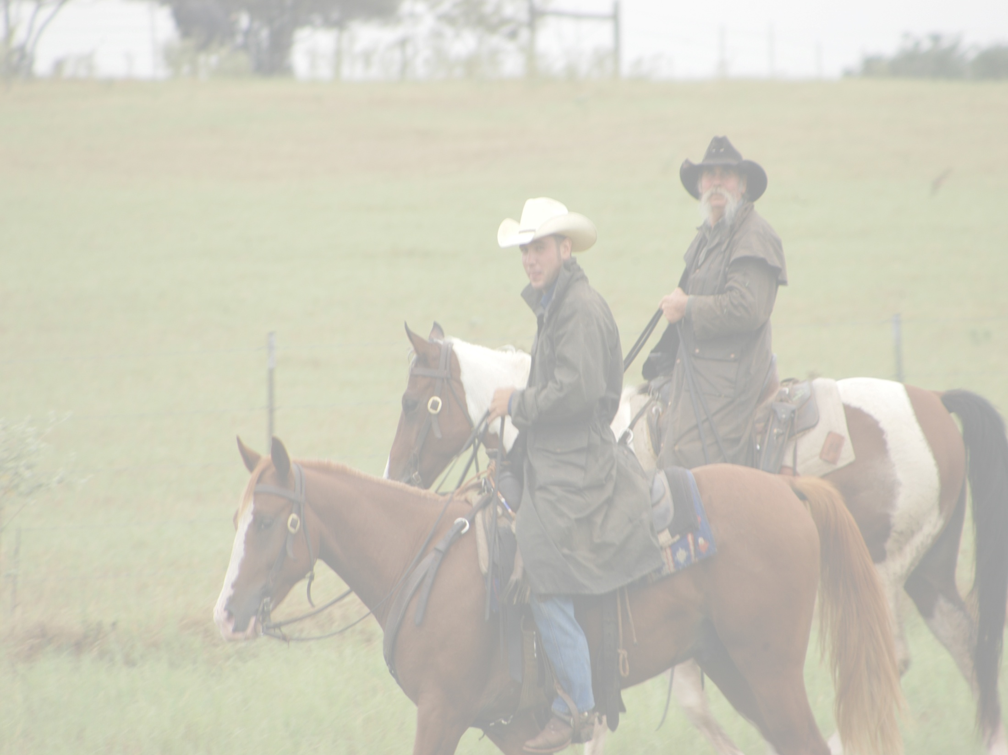
Local Data
AVG RAINFALL 38 inches/year
AVG TEMP YEAR ROUND 68 degrees F
AVG FIRST FROST DATE First Week December
AVG LAST FROST DATE Last Week March
AVG GROWING DAYS/YEAR 265 Days

Slide 11
WATER

Slide 12
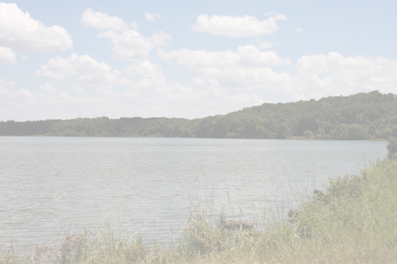
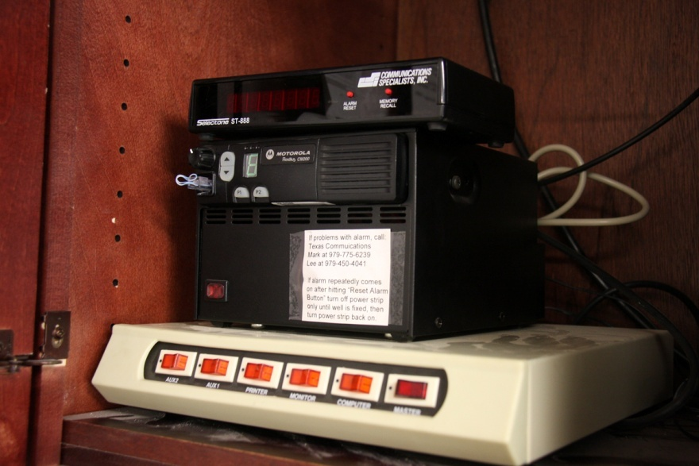
Camp Cooley Ranch Water
19 water wells (average depth 300ft)
Sophisticated Electronic Well Monitoring System
Supplies water to pastures, homes and office
5 Artesian Water Wells
Several Natural Springs
Irrigation Wells average depth 500-900ft, pumps 225 GPM
Navasota River on Eastern Boundary
Four larger lakes
60 acres
30 acres
25 acres
10 acres
Approximately 8 other smaller ponds.

Slide 13
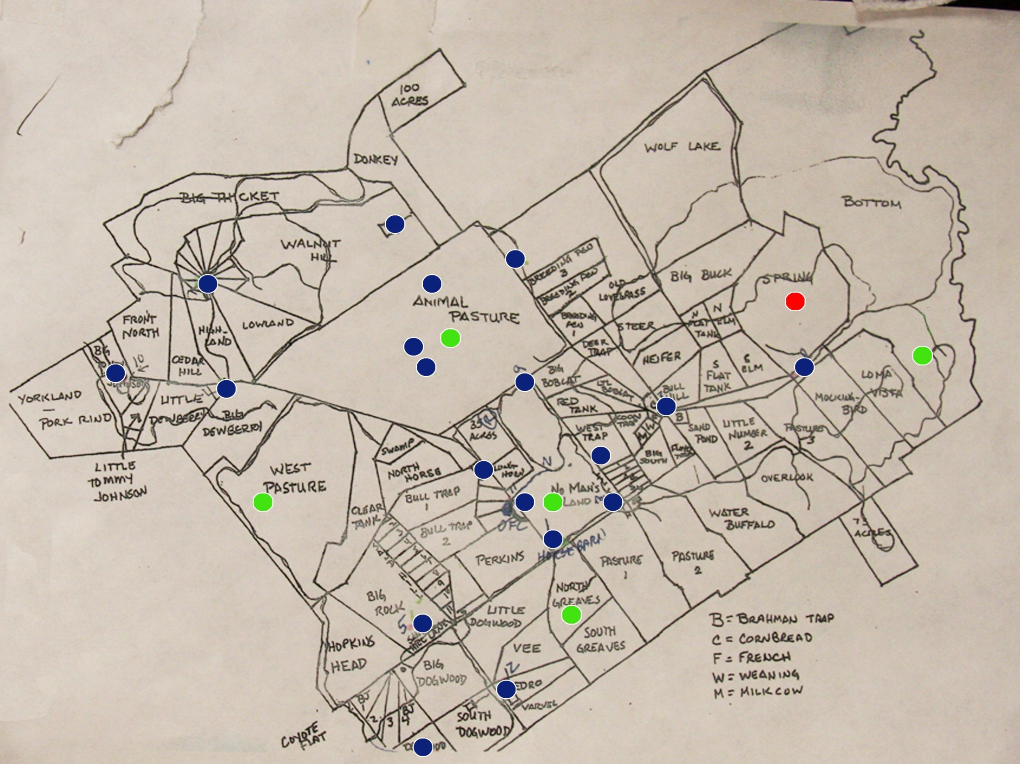
Map of Water & Irrigation Wells
Blue Dots – Water Wells
Green Dots – Irrigation Wells
Red Dot – Pivot System

Slide 14
Water
Carrizo Wilcox Aquifer
The Carrizo-Wilcox Aquifer in Texas makes up part of the larger Texas Coastal Uplands Aquifer System
Extends from the Rio Grande in South Texas and into parts of Arkansas and Louisiana.
Supplies water to 60 Texas counties.

Slide 15
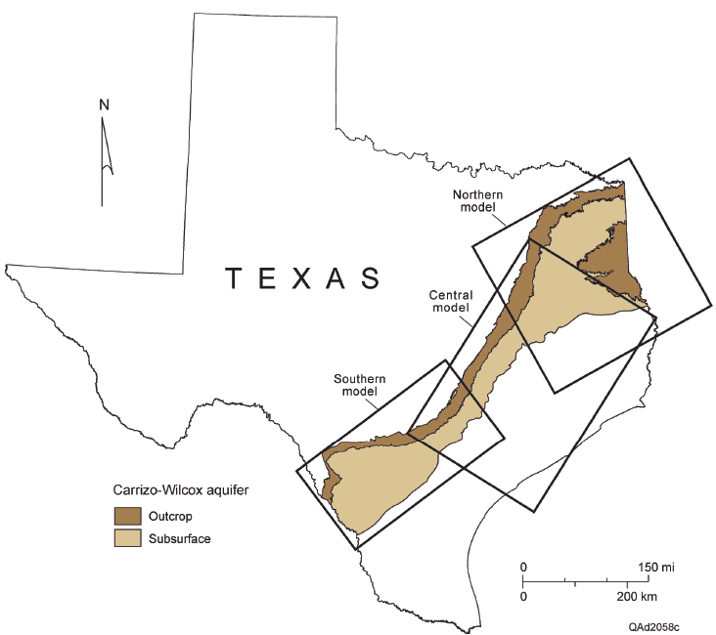
Carrizo Wilcox Aquifer

Slide 16
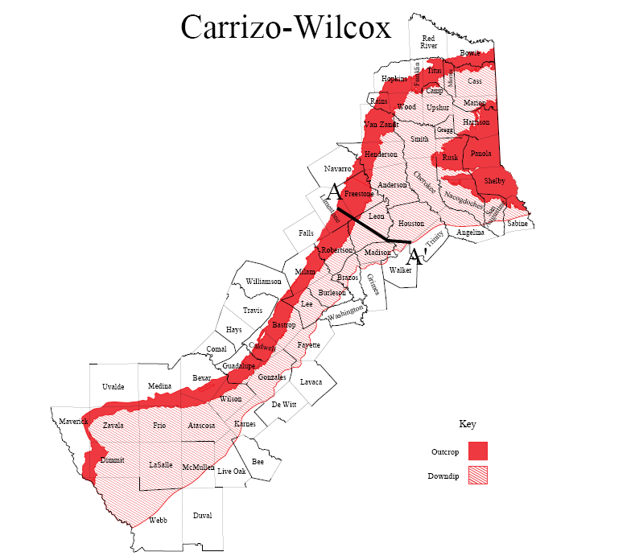
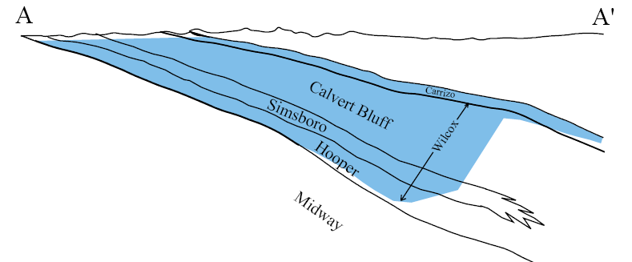

Slide 17
MINERALS

Slide 18
Minerals
Camp Cooley Ranch is offering for sale certain mineral and royalty interests located in Texas, or more specifically, the Cotton Valley Lime/Deep Bossier formations (the “Properties”).
*Refer to supplemental information

Slide 19
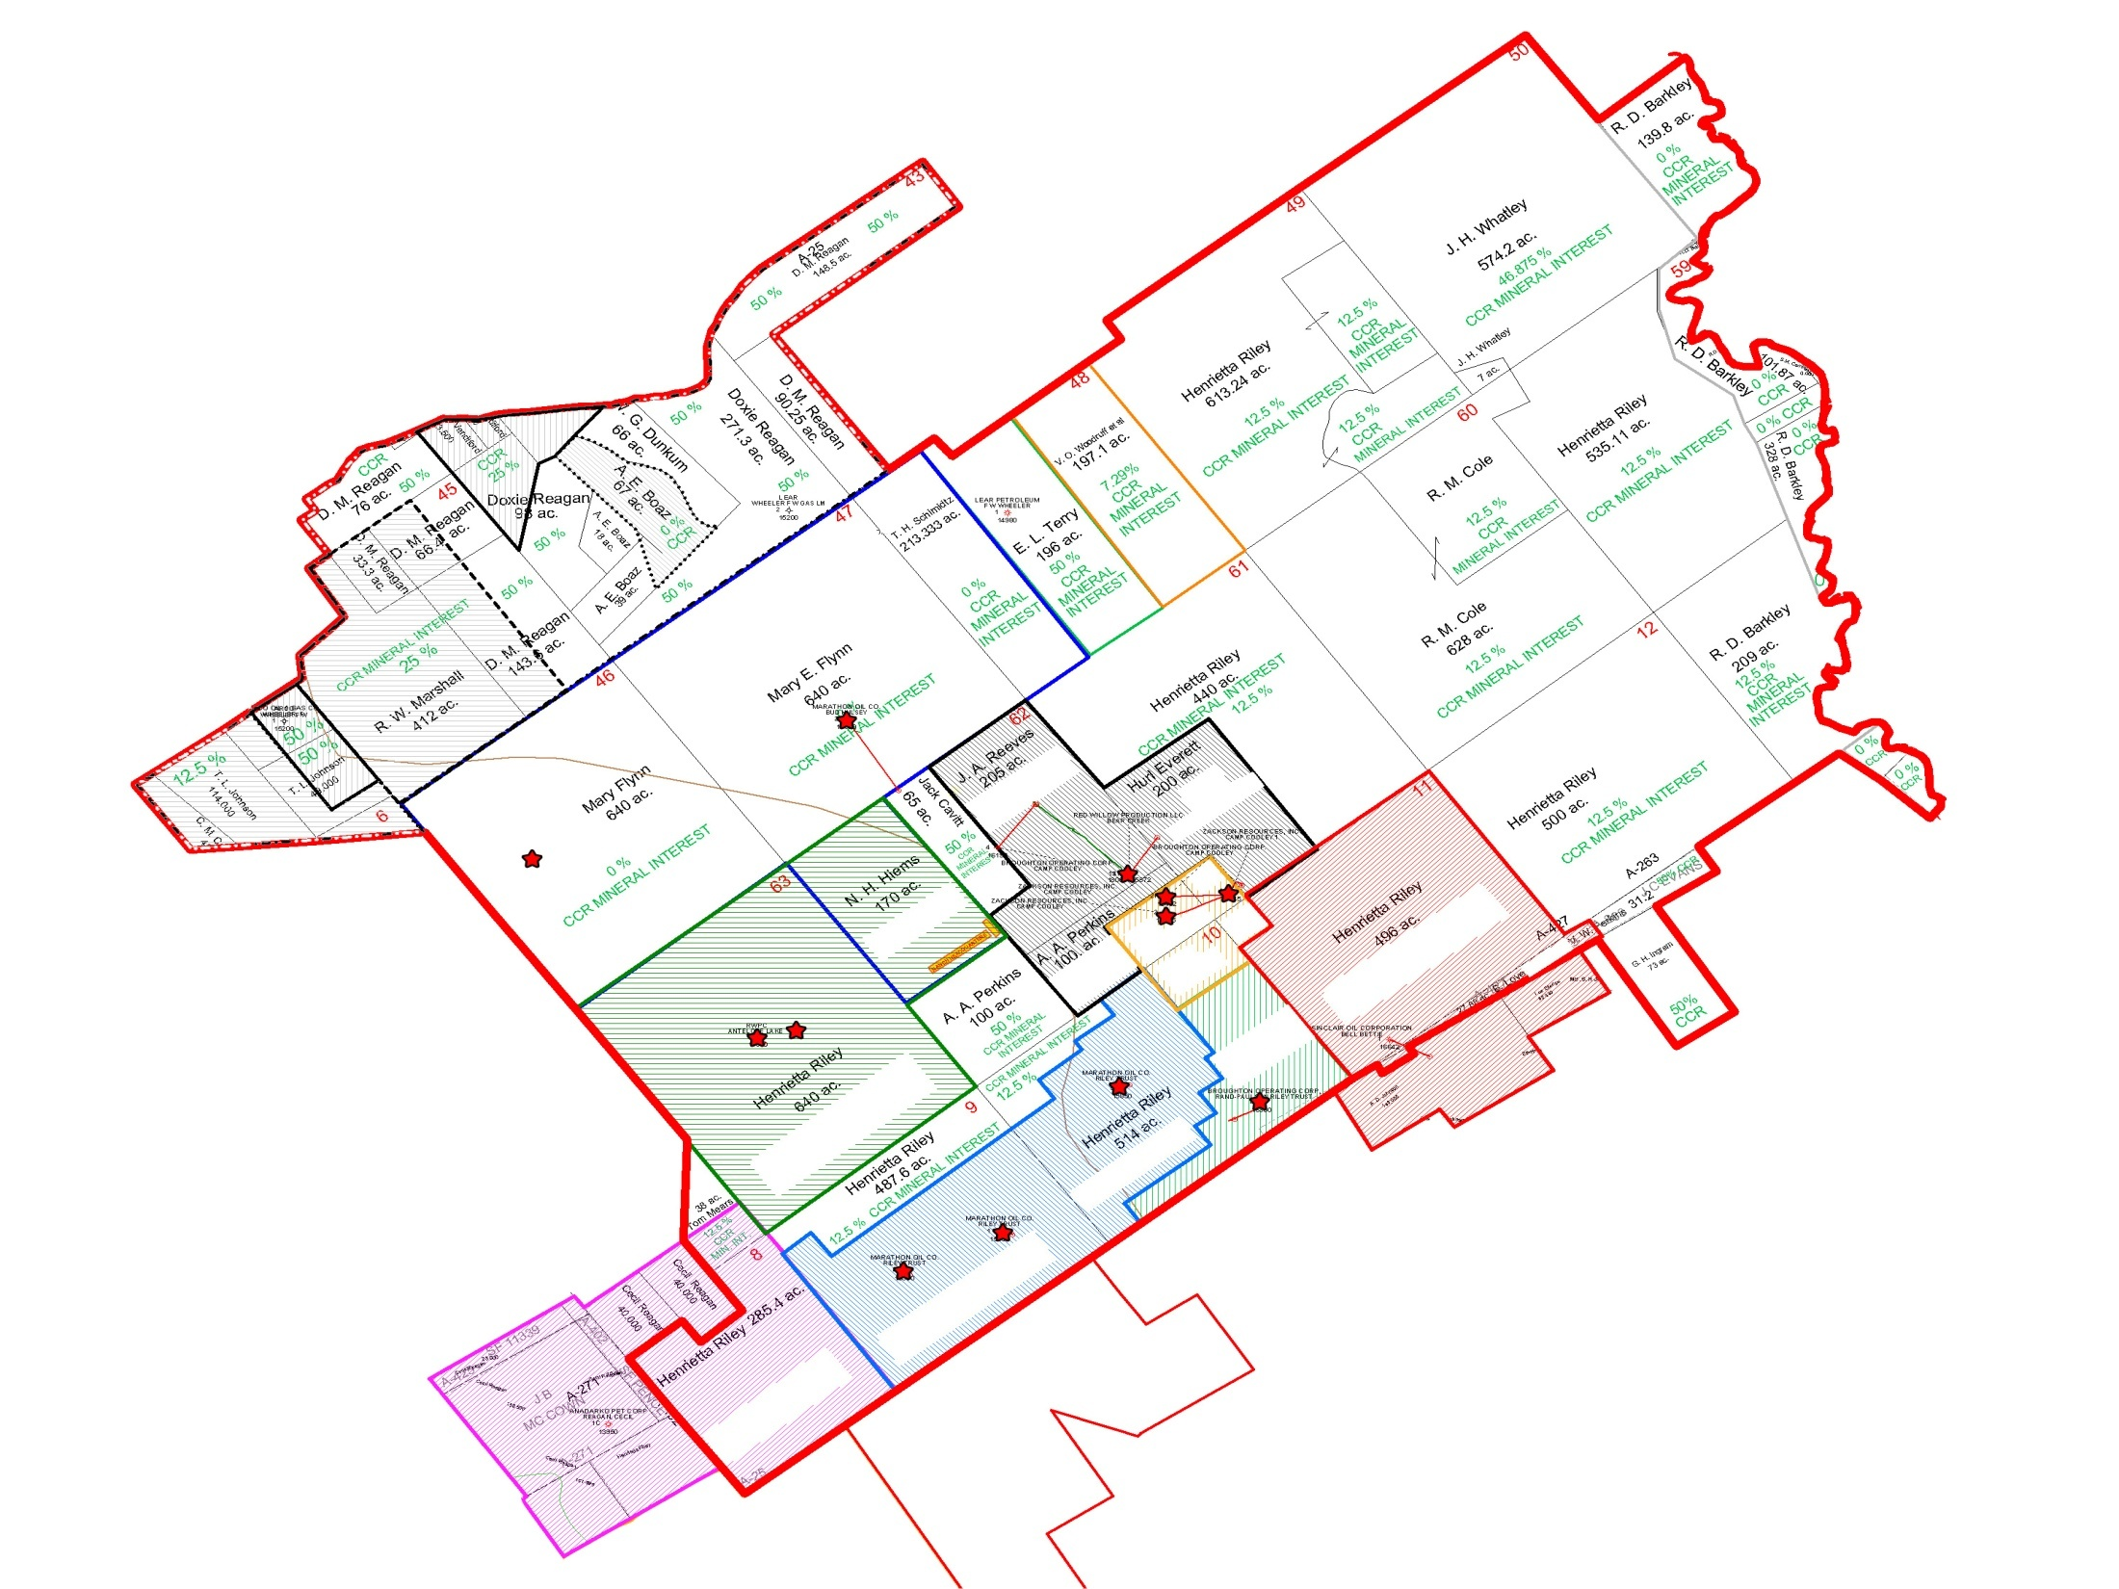
Map of CCR
Producing Wells

Slide 20
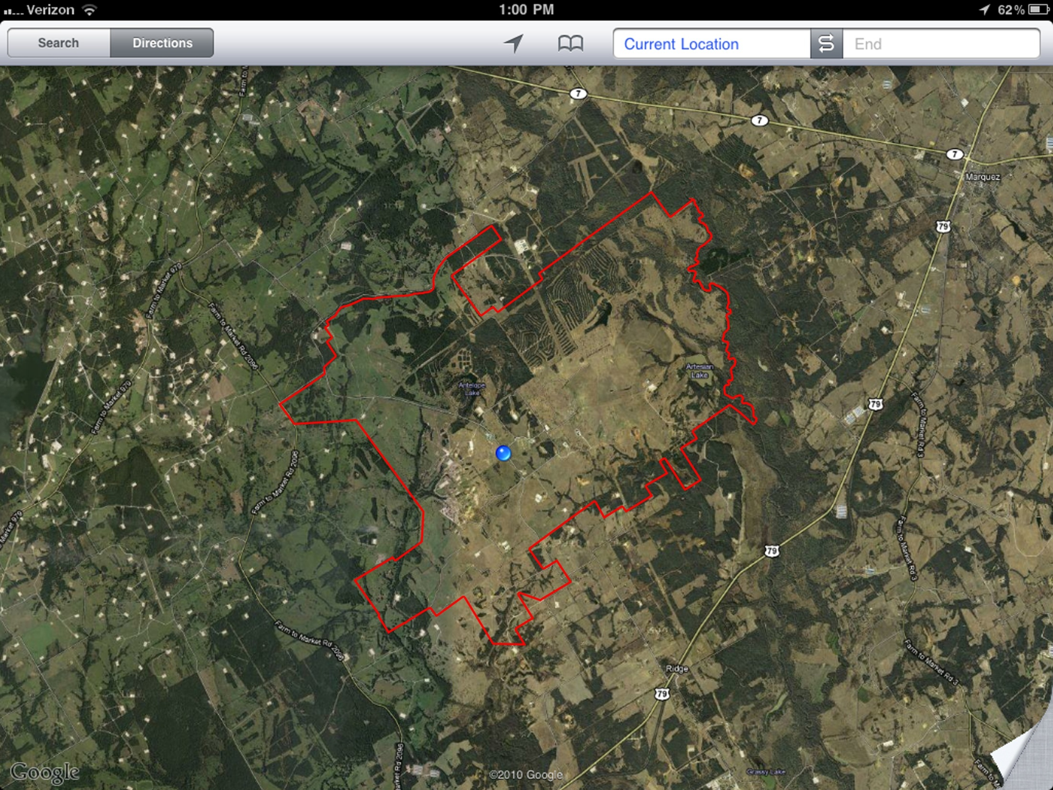
Pad Site Saturation
CCR vs Surrounding Areas
As Captured via Google Earth March 17, 2011

Slide 21
HAY PRODUCTION

Slide 22
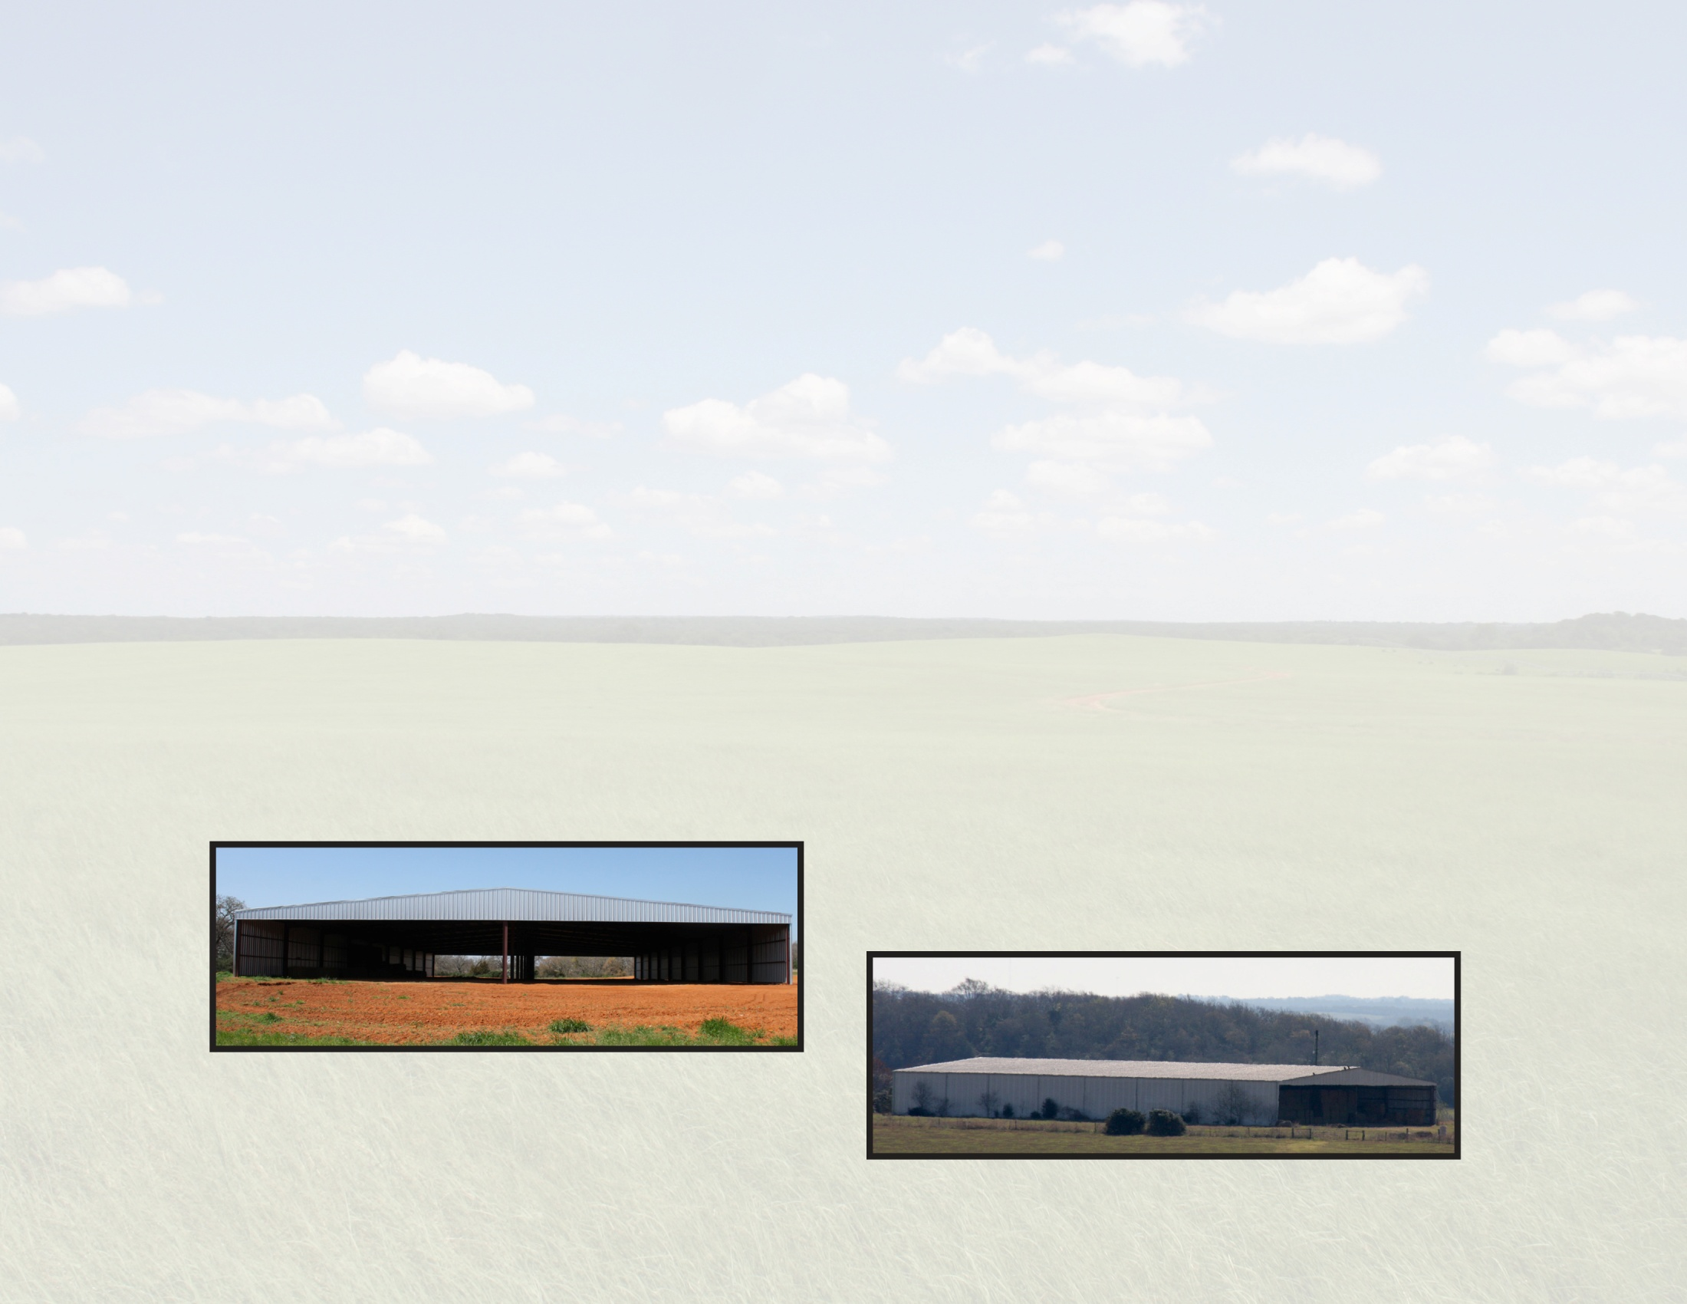
Current Operations
Hay Production
Total 2010 Hay Production (Partial Year)
• From a total of 9 pastures & road
(with max of 3 cutting on some pastures)
• Square Bales - 79,533 @ $5.50/bale
• Round Bales - 3253 @ $55.00/bale
Projected 2011 – 1.5 X’s 2010
* NB .
Exist. Barn 85,000 squares capacity
New Barn 65,000 squares capacity

Slide 23
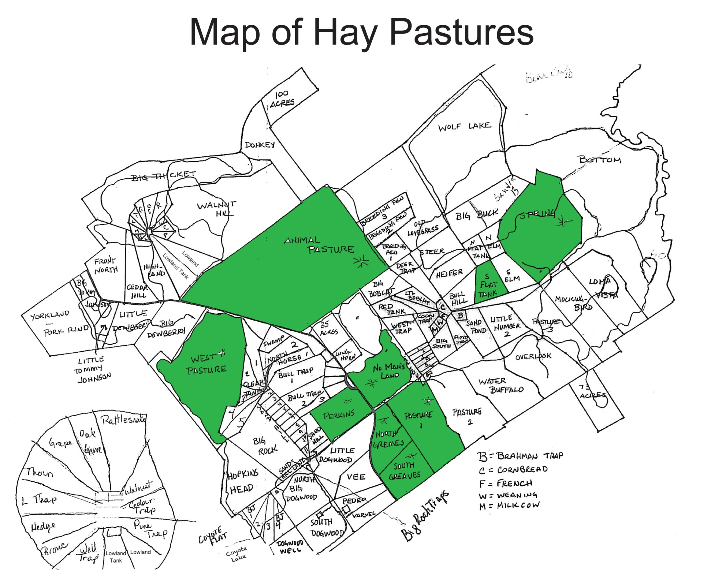
Green Areas are fields cut in 2010

Slide 24
Current Operations
Hay Equipment
Not Pictured
Bale Bandit, Second Large Tractor, Round Baler

Slide 25
GRAZING LEASES/CATTLE MGMT

Slide 26
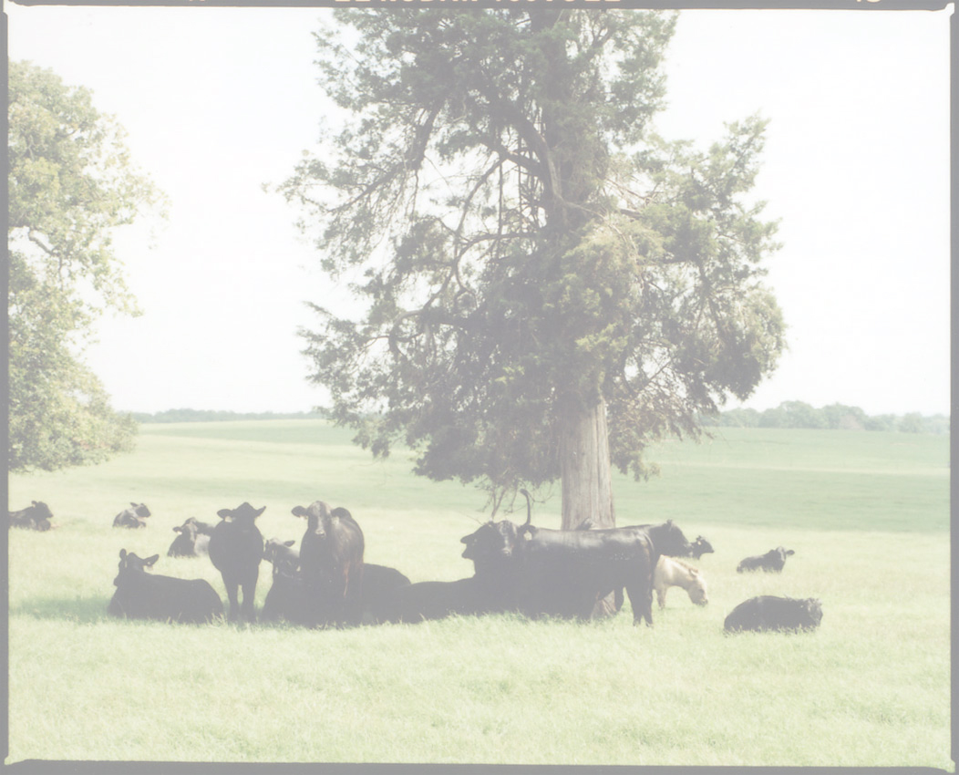
Current Operations
Grazing Leases
17 Total Leases Signed and In Use
Of the 17 Leases, 10 of them would have 95% of the cattle
Total of 4749 Head of Cattle (CCR Maximum Capacity)
1576 Head of Stockers,
Scheduled to leave the ranch in Mid to End of July 2011
Current Pricing Schedule for Leases
$15/head - Cow
$12/head Heifer
$10/head – Stocker
Plus cost of Hay (@ $55/bale) and Feed
Total Income Per Month on Lease Cattle $62,072 (lease cost only)

Slide 27
ENVIRONMENTAL
MITIGATION BANKING
*Refer to supplemental information

Slide 28
Mitigation
Current contract with Leading National Environmental Mitigation Banking Expert.
Gross $70 M (+/-)
$22.5 M (+/-) Net to Landowner(s)
Revenue Share Offered

Slide 29
Camp Cooley Bottom Lands
The Eastern boundary of Camp Cooley Ranch is the Navasota River. (approx 1.5 miles)
1450 acres (+/-)
Lake Limestone supplies the Navasota River with a contributing drainage area of 675 sq miles.
The Robertson Dam on Lake Limestone stands 72 feet tall with a emergency spillway measuring 3,000 feet.
When full, the lake covers a surface area of 12,680 acres and holds back 225,440 acre feet or 73.5 billion gallons of water.
Periodically (with notice) the dam is opened & floods the Navasota River Bottoms and downstream land.

Slide 30
IMPROVEMENTS & INFRASTRUCTURE

Slide 31
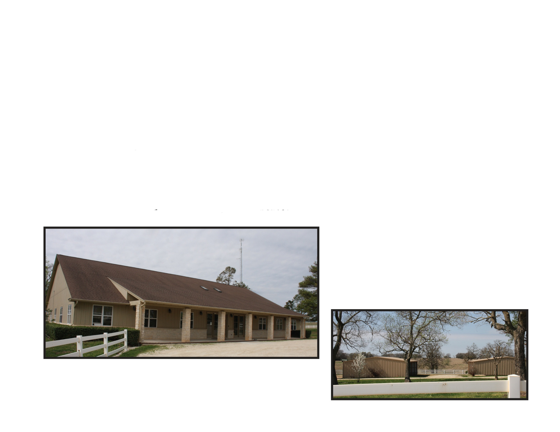
Main Office Facility
7000 Sq Foot
2 Conference Rooms
16 Individual Offices
Safe Room
Two large storage rooms
Fully functional Fiber Optics
Computer Server Room
Copy Room
Mail Room
10’ x 70’ Truck Scale / Weight Station
Centralized Radio System transmits throughout Ranch
Security System with video monitoring controls

Slide 32
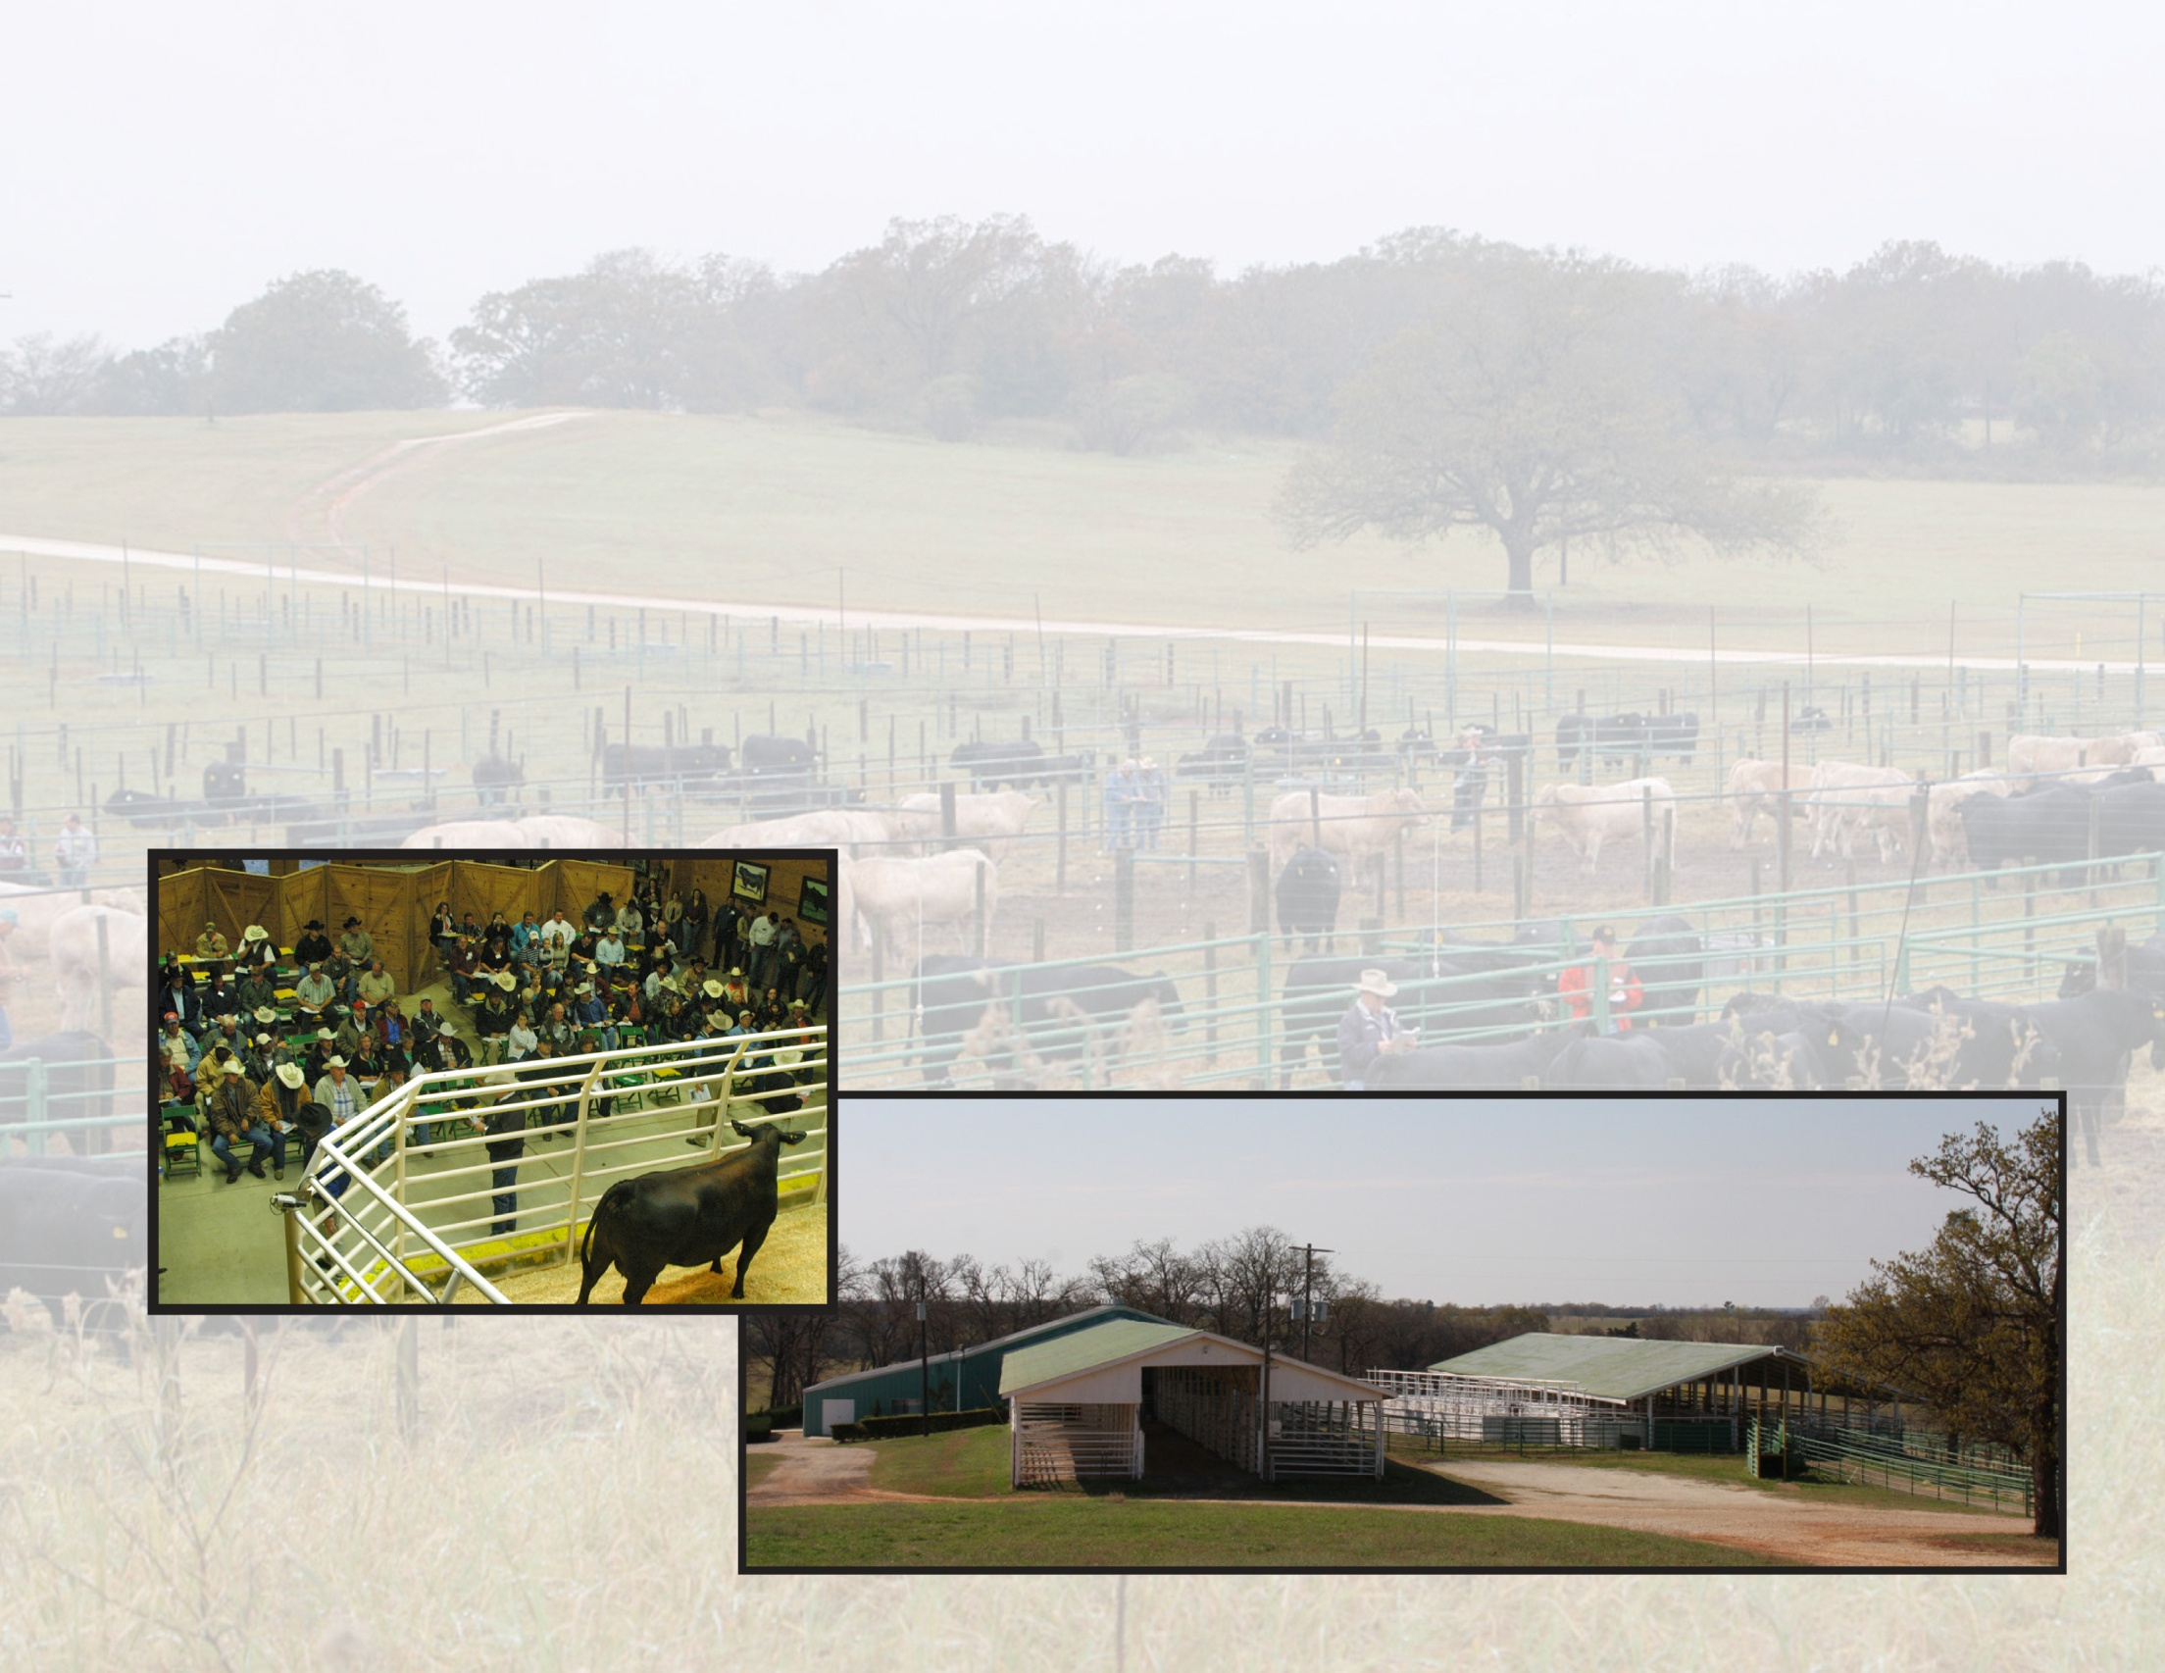
Sale Barn Facility
Fully Functional Sale Facility
Air Conditioned / Heated
Phone lines and DSL via fiber optic cable
Meeting room, storage rooms and sales ring
Holding pens for upwards of 1000 cattle all with water
Unlimited International sales capabilities
Cattle Sales in excess of $25 M

Slide 33
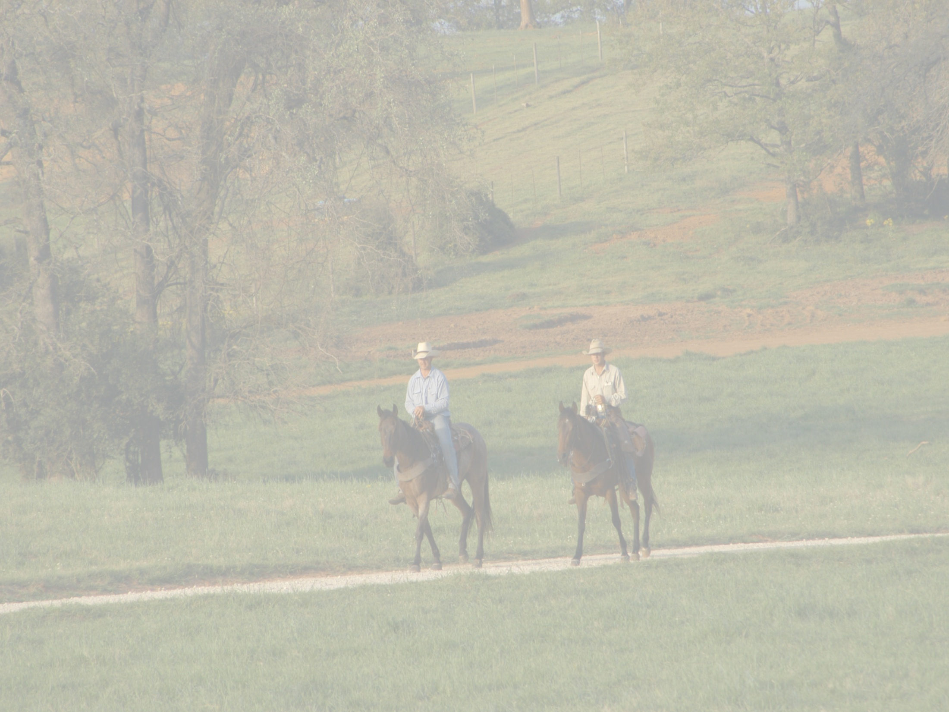
Additional Ranch Working Facilities
26 Stall horse barn
Embryo transfer facility
Grain storage facility
Large shop
Bulk fuel station
Multiple Hay Barns
Numerous working barns
Equipment sheds
Storage sheds
Lumber barn
Etc.

Slide 34
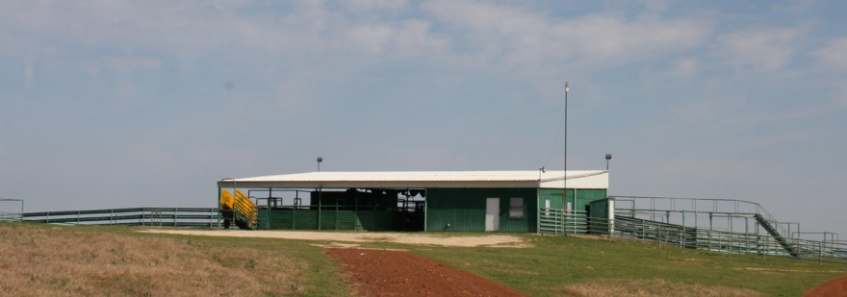
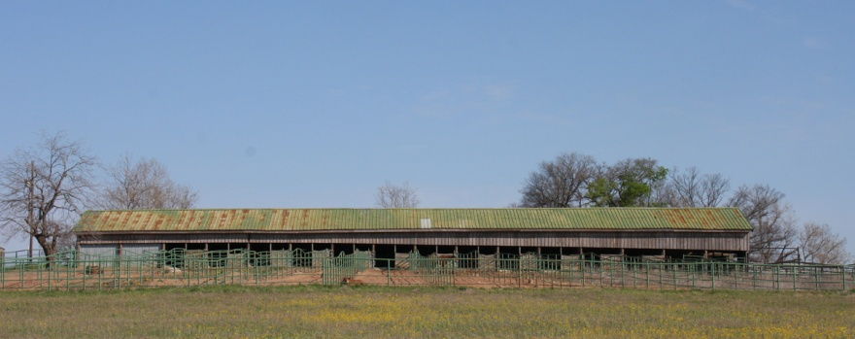
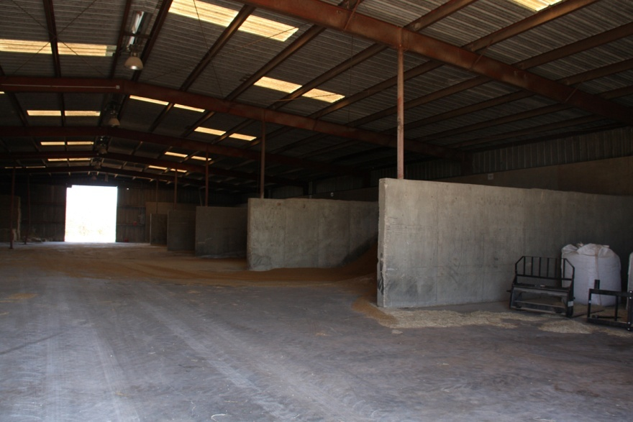
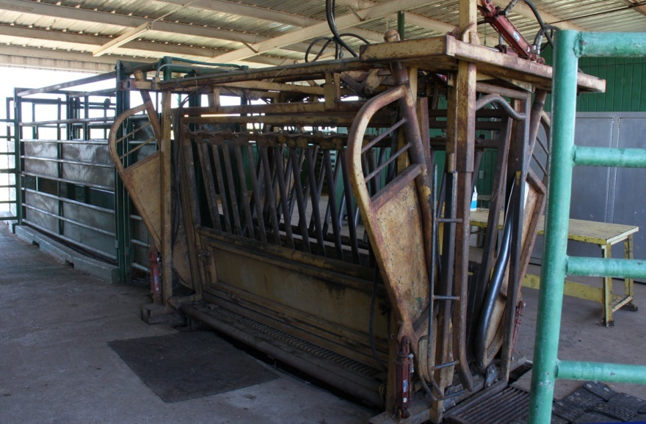
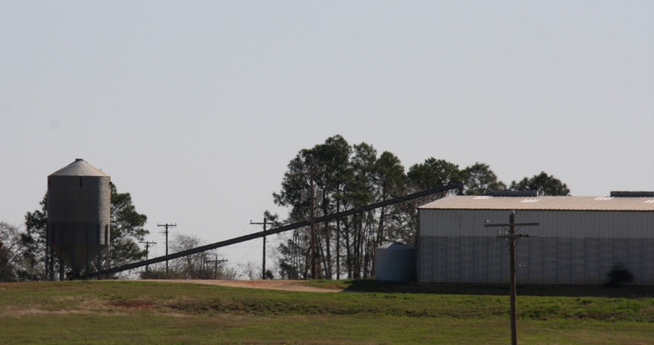
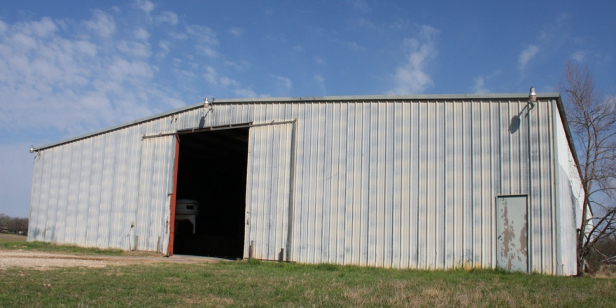
Ranch Working Facilities

Slide 35
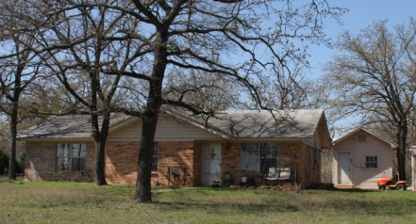
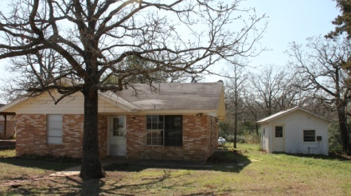
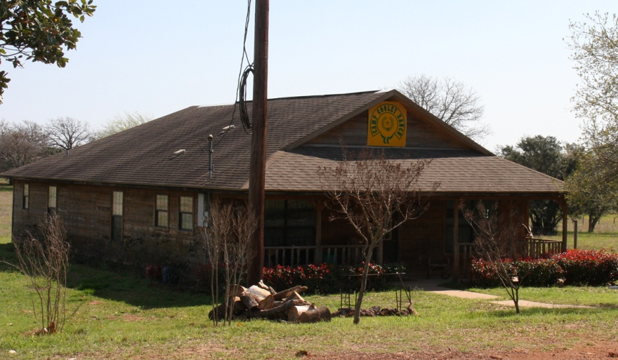
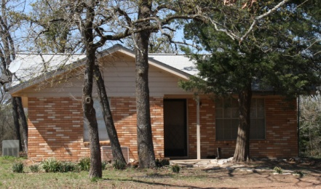
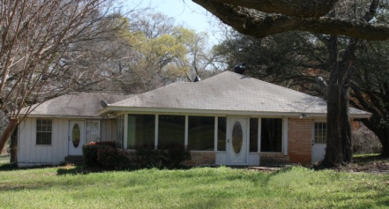
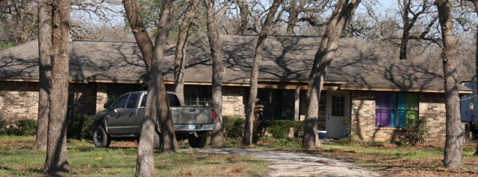
Housing
Main Home/Lodge
Nine Wood/Frame/Brick homes
Two double wide mobile homes
Three single wide mobile homes
Fully furnished three bedroom bunkhouse

Slide 36
EXOTICS

Slide 37
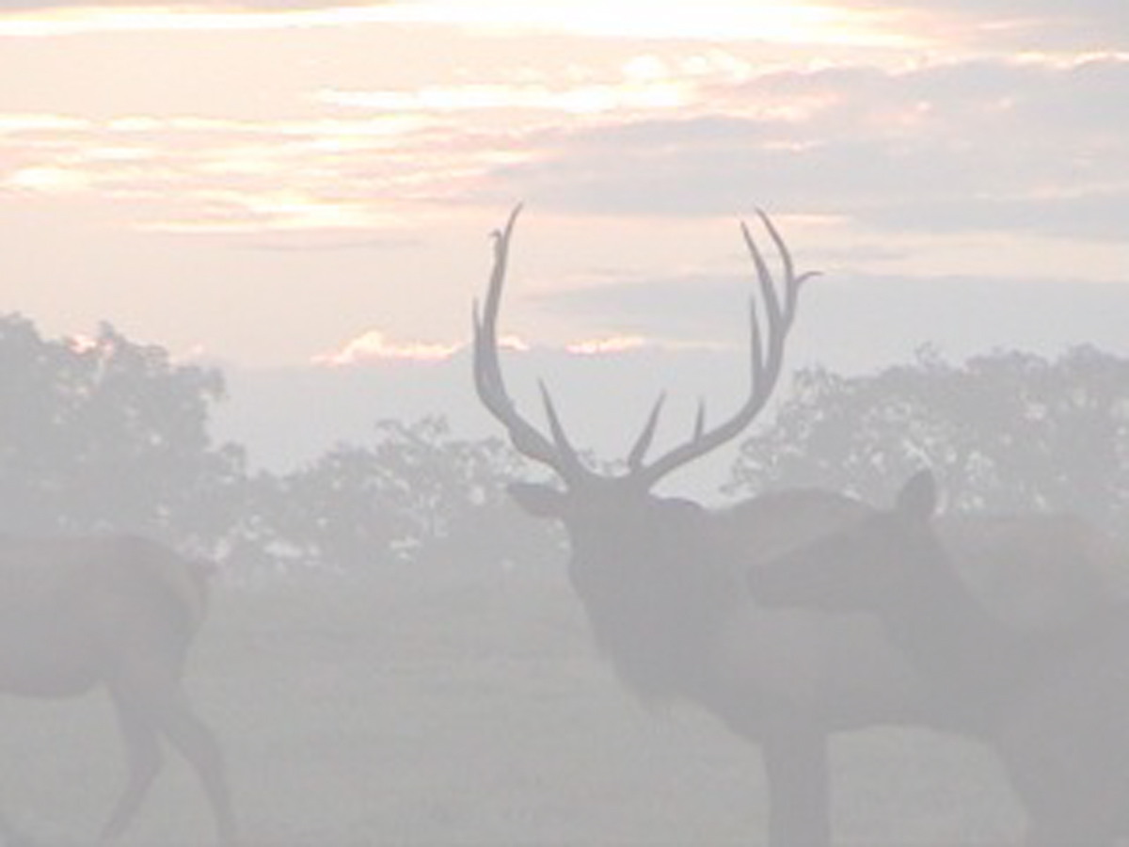
Game Preserve
Oldest Game Preserve in Texas
1000 Acres
Stocked with
  Axis Deer Elk
  Barasingha Deer Fallow Deer
  Black Buck Impala Gazelle
  Eland Antelope Kafue Lechwe
  Sika Deer Whitetail Deer

Slide 38
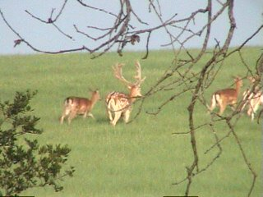
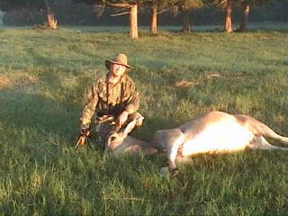
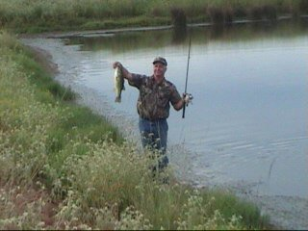
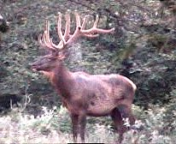
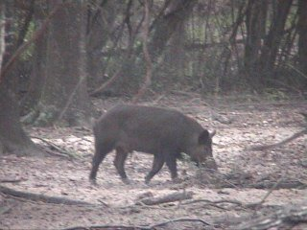
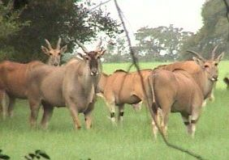
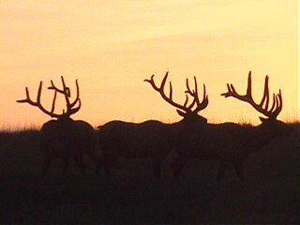
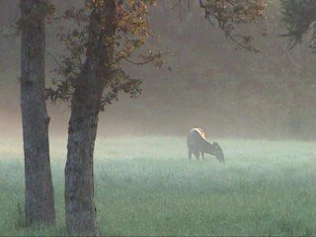
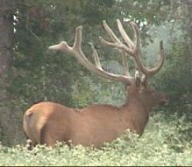
Hunting

Slide 39
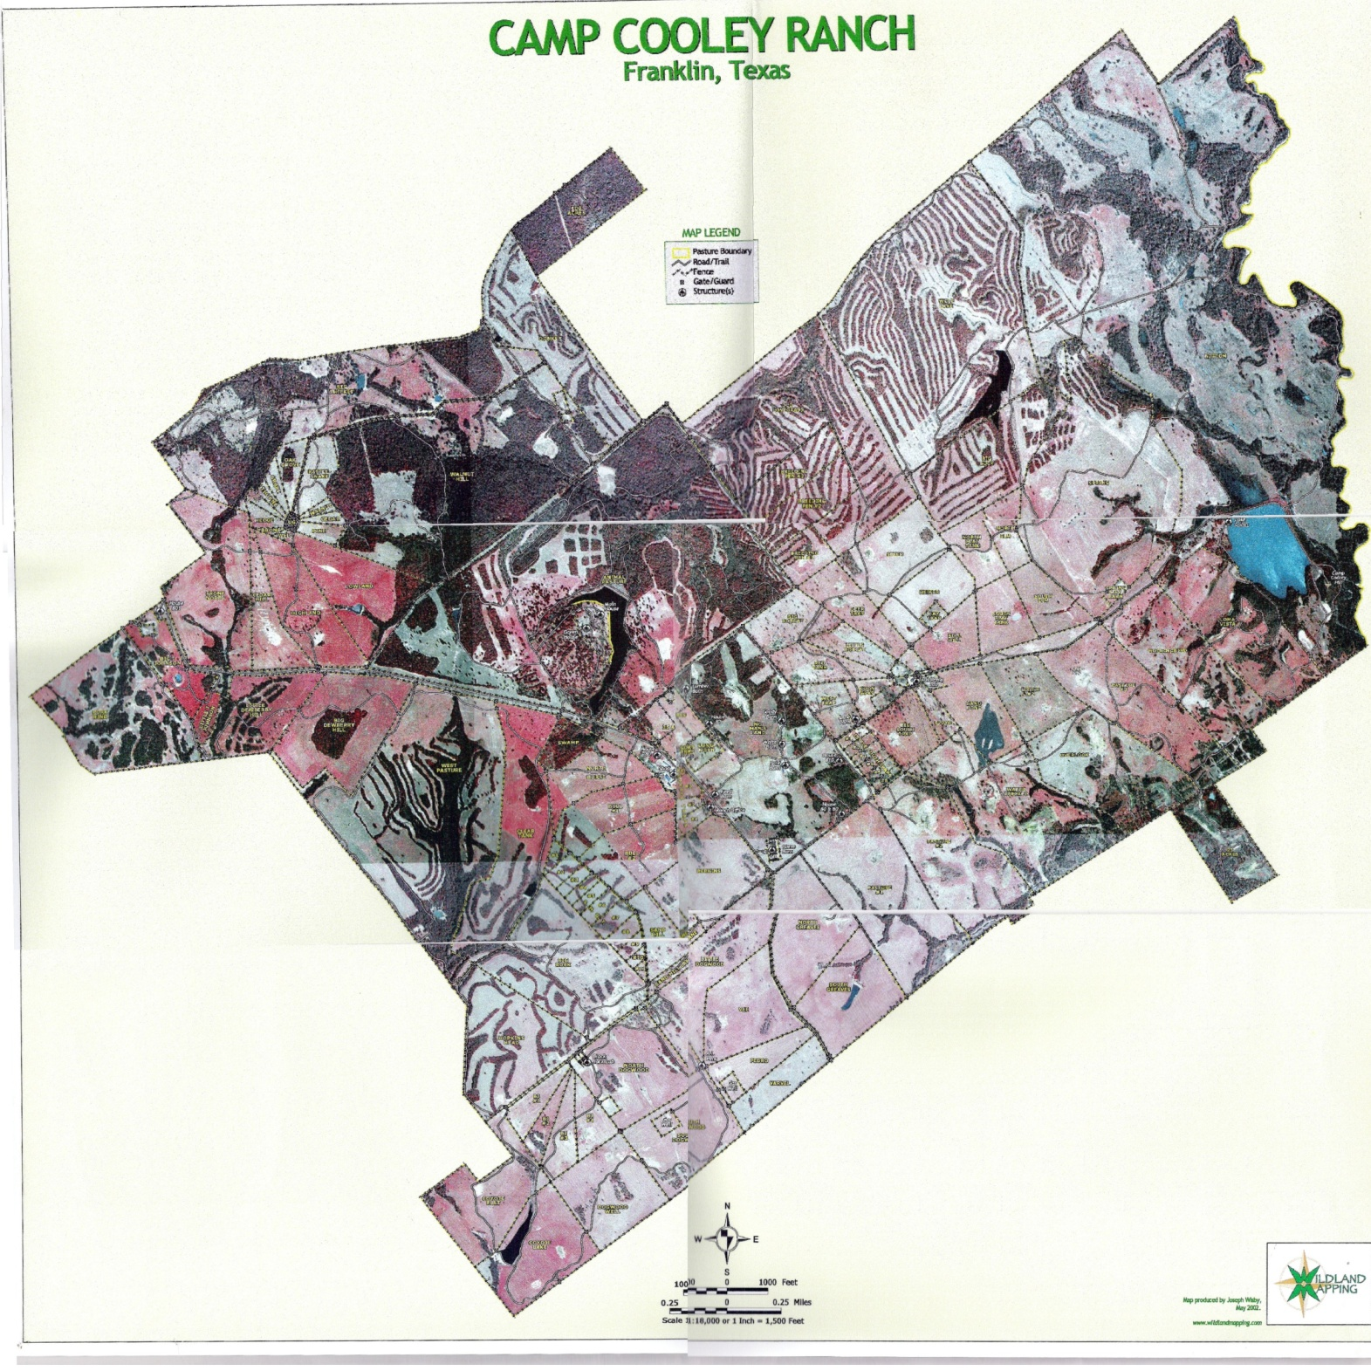

Slide 40
Camp Cooley 2010 to Present
2010 New Core Operations Commence Commercial Hay Production
Grazing Management
November 2010
Final Sale of Cattle, Embryos, Semen, Repro. Equip.
December 2010
Ranch began promotion of facilities for rental purposes.

Slide 41
Camp Cooley Ranch Sale Timeline
January 2011
Settlement with Lenders regarding Chapter 11
February 2011
CCR Offered Publically to Open Market
March 2011
First Offers Received
March 29, 2011
Final for Minerals Only
April 15, 2011
Finals for Turnkey Operation

Slide 42

Camp Cooley Ranch
For More Information Contact
Mark Coleman / Broker
at (903) 738-9420
Or at farmnranch@aol.com
www.campcooleyranch.com

