Slide 1
2002 ACRE CAIMAN RANCH
HEADQUARTERS PASTURE
LASALLE COUNTY, TEXAS
Offered exclusively by:
Gardner Ranch Sales, LLC
Derry T. Gardner, Agent
210-737-1321; 210-288-4492
www.gardnerranchsales.com

Slide 2
The Caiman Ranch was originally a portion of the 250,000 acre Callaghan Ranch. In 1947, Mr. Henderson Coquat bought a portion of the northern section of the Callaghan Ranch from Ralph Eades and the Beall Estate. In less than a year after that purchase, Mr. Coquat traded the western half of that section to Kenneth C. Miller for an interest in a portion of the Brown oil & gas lease in Rust County, in East Texas .
Miller named his new ranch the “Caiman Ranch” for a creek of the same name running through the northern part of the Property. The caiman, an animal similar to the alligator or crocodile, and found in South America, was often seen in the area of the creek. Many caiman were sighted on the ranch, the last seen in 1957.

Slide 3
Located near this house was the road that was once a part of the Old Camino Real, or the Royal Highway, which was the stage road running from Mexico City to San Antonio, Texas. The Royal Highway crossed the Nueces River approximately 25 miles southeast of Cotulla at what was later known as the Huajuco Crossing, and meanders on through the Caiman Ranch. The Royal Highway was also the road that Antonio Lopez de Santa Anna led his men to the Alamo in 1836.
In 1974, Mr. Miller died, and the ranch became part of a trust left to his only child &
her 4 children. In the 27 years Mr. Miller
owned the Caiman, he built it into a
prize winning cattle ranch with champion
Charolais and Charbray cattle.
In 1978, Mr. Miller’s son –in-law took over the management of the Caiman , building
two stock tanks and implementing the
savor-cell grazing management
system to allow more cattle to be
grazed on less land, with less stress
on the land.
In 1990, he opened up the ranch to
commercial hunting of whitetail deer, feral
hogs, and quail. His excellent management
practices resulted in the ranch being awarded
the 1995/96 South Texas Plains Lone Star
Land Steward Award, sponsored by the Texas
Parks & Wildlife Department.

Slide 4
The Caiman Ranch is situated in southwestern Texas approximately 140 miles south of San Antonio, Texas, and about 55 miles northeast of Laredo, Texas. The property is an irregularly shaped tract of native rangeland located approximately 20 miles east of Encinal, Texas in south central LaSalle County, along the north side of Coquat Road.

Slide 5
This South Texas area has long been touted as the Promised Land for bruiser whitetail bucks. The area the property is located on is truly a world of its own. It’s dry, level to gently rolling country is laced with a combination of live oaks, mesquite, elm and hackberry trees, along with a myriad of thorny plants, brush, and species of cactus, all producing excellent whitetail deer habitat.
Topography of the Caiman Ranch ranges from level to gently rolling. The general flow of drainage is from the southwest to the northeast towards the Nueces River, and along Los Olmos Creek which traverses through the western section of the property. The terrain on this ranch is diverse, starting with level or flat areas in the southeastern section, to more rolling areas in the northwestern section. There are several low lying drainages along with Los Olmos Creek. The elevation ranges from a high of approximately 393‘ at the main entrance gate in the far southeastern corner of the property, to a low of about 322‘ in the Los Olmos Creek bed, in the northwestern section of the ranch.

Slide 6
Soils on the Caiman are clayey or loamy surface layers with saline, clayey or loamy soils, all of which are key to the excellent diverse vegetation on the ranch, along with an excellent mixture of South Texas brush species – there is a semi-dense to dense cover with a medium to high canopy, providing some of the best deer habitat in all of South Texas. Openings are scattered throughout the brush, senderos,, fence lines, and stock tanks providing an edge effect for the wildlife.

Slide 7
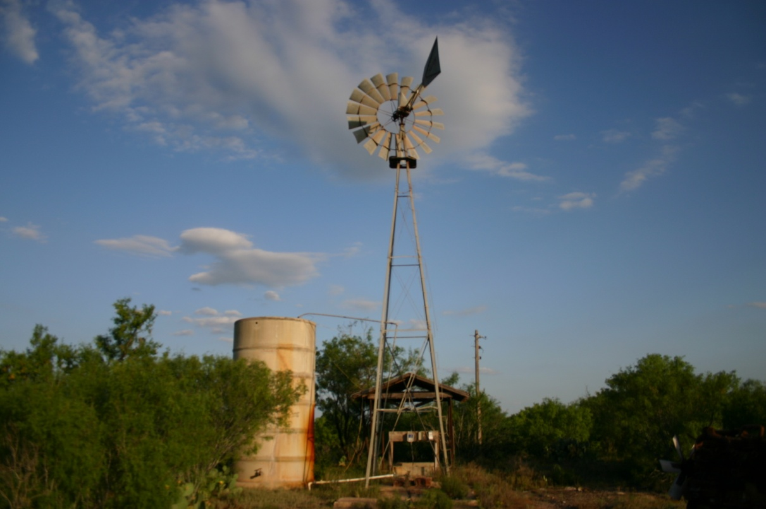
The Caiman Ranch is entirely perimeter fenced and cross fenced into 4 pastures. The entire eastern boundary line is fenced with 8’ net wire game proof , with the remainder fenced in typical barbed wire. There is a 4,280 foot deep water well out of the Carrizo Aquifer, equipped with an electrical submersible pump supplying water to the HQ area, one stock tank , and various water troughs. There are 3 earthen stock tanks scattered throughout the ranch.

Slide 8
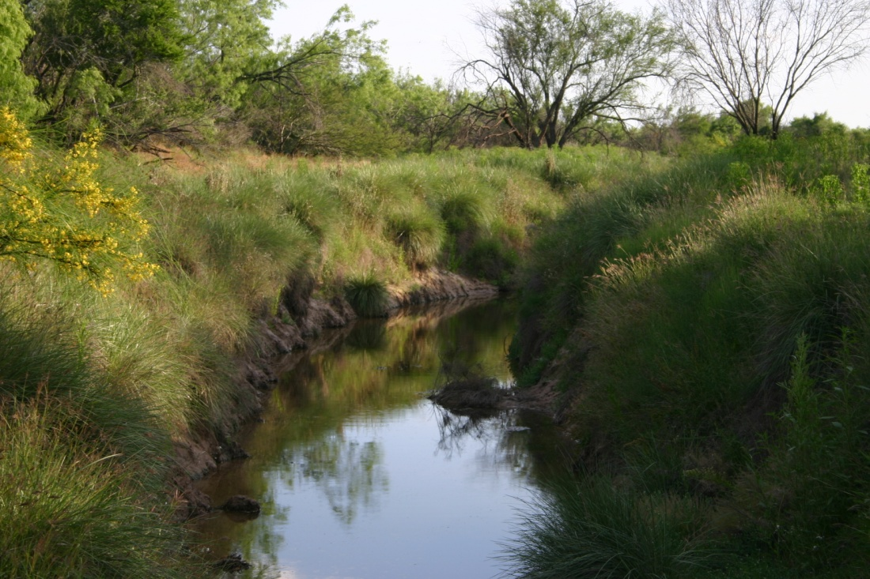
Olmos Creek flows through the western section of the
Caiman Ranch. This creek is a wet weather creek, but
does hold pockets of water for extended periods of time.

Slide 9
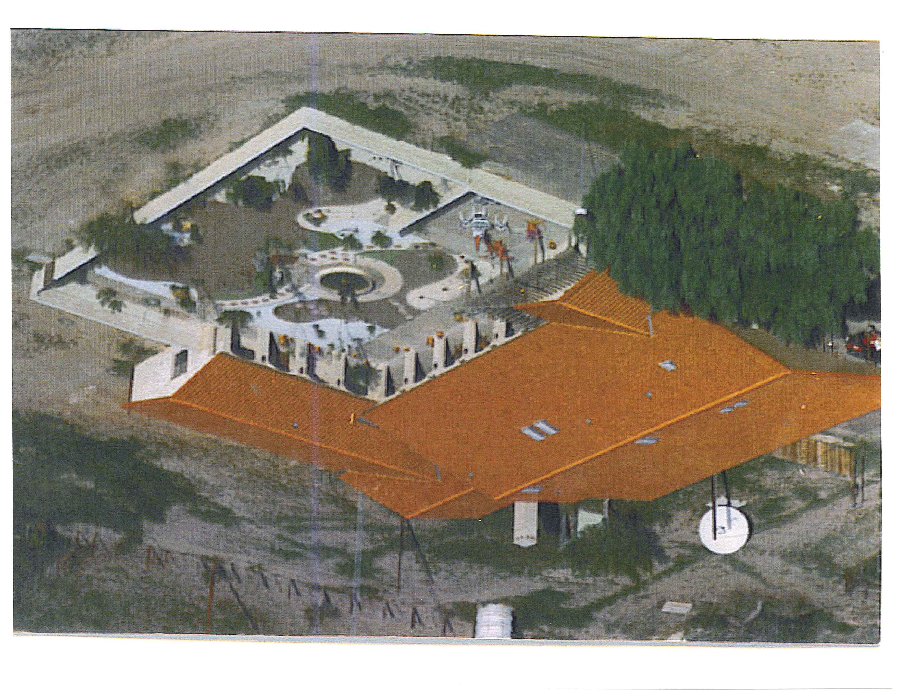
The 4,200 sq. ft. , 6 bedroom, 5 bath hacienda at the Caiman Ranch HQ is of a Spanish style with deep porches, a walled large courtyard surrounding the main house, complete with a fountain. The hacienda is built on a concrete slab, with a stucco exterior, saltillo tile floors, mostly 9 foot ceilings, and ceiling fans through out.

Slide 10
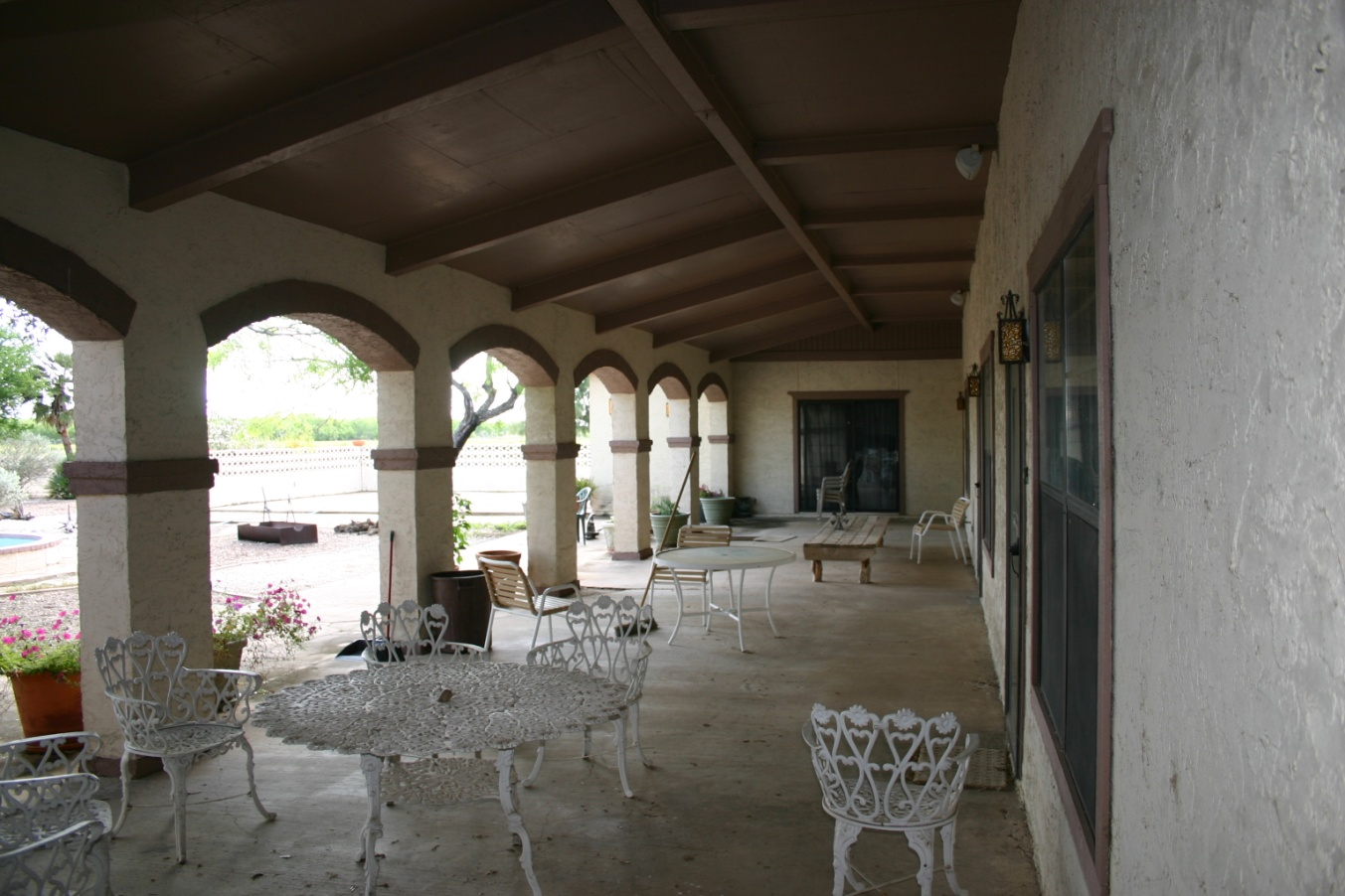

Slide 11
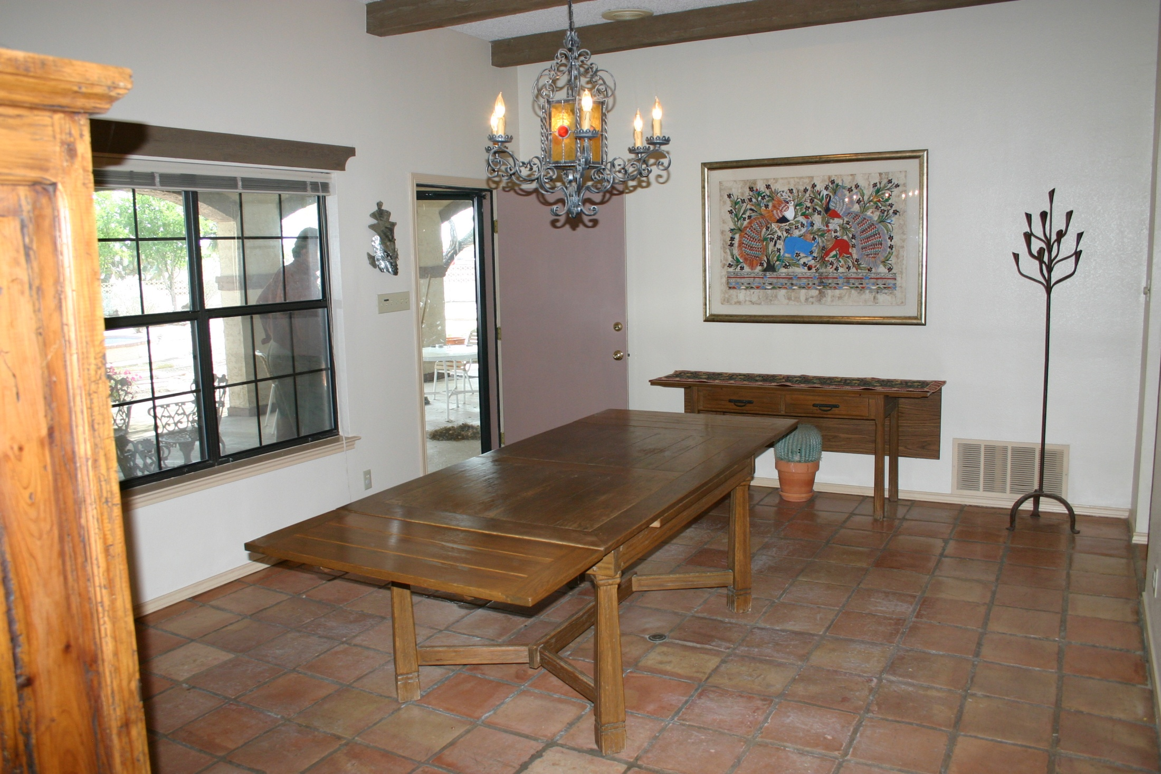
The kitchen is appointed with
oak cabinets, a Jenn-Aire surface
cook top, double oven door, ice-maker
and disposal. The large dining room
sits at least 8, with a view of the
courtyard and fountain. The living area has
a game area, bar, and fireplace.

Slide 12
At the headquarters area, there is a 2,665 sq. ft. barn, with a sheet metal exterior , enclosed on two sides, with electricity , and a dirt floor.

Slide 13
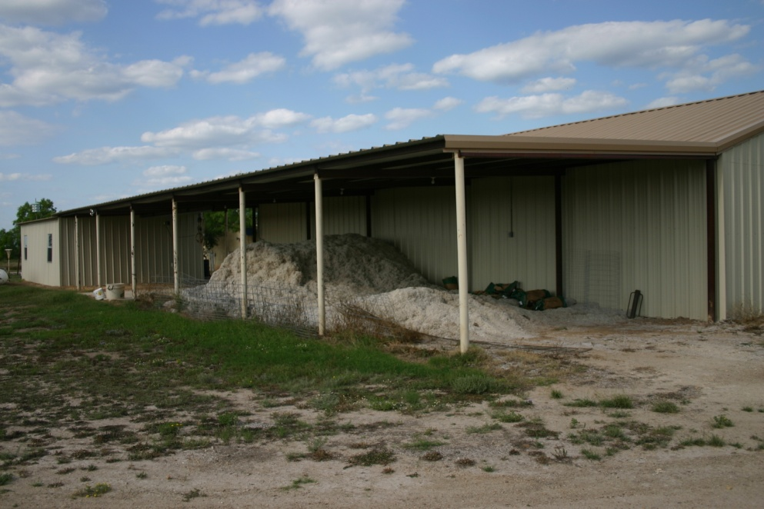
The foreman’s house is located at the headquarters area, and is 1,700 sq. ft., 3 bedroom, 2 bath house, with central air and heat, with carpet and tile floors. The 600 sq. ft. workshop is next to the foreman’s house, and is equipped with electricity and an enclosed tool room. Additionally, there is a 1,640 sq. ft. implement shed, enclosed on one side, with seven stalls and a game cleaning area and hoist.

Slide 14
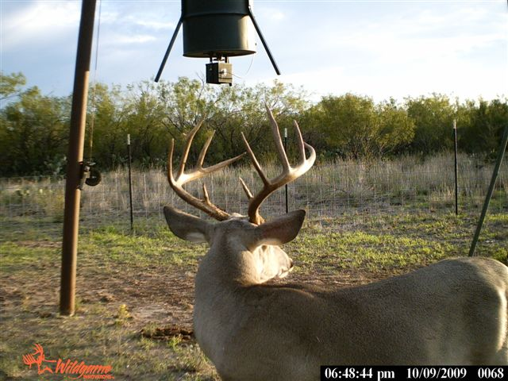
This is the reason the Caiman Ranch has the reputation as one of the best
Whitetail hunting ranches in Texas. Take a look at a few more pictures.

Slide 15
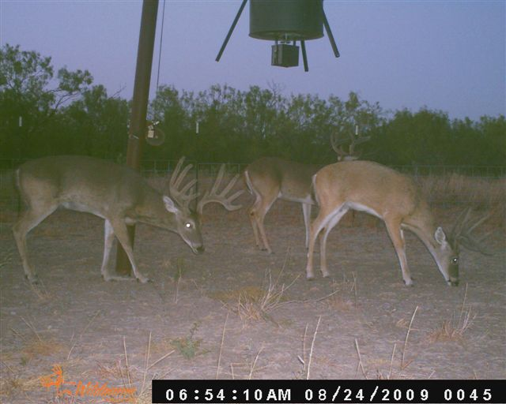
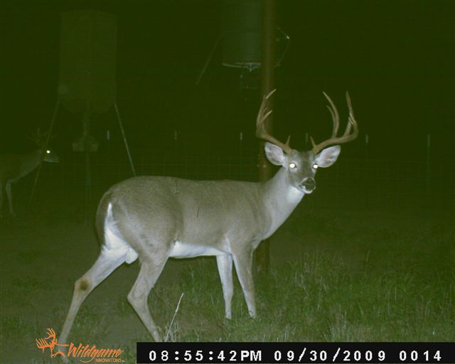
The Caiman Ranch has been
producing trophy whitetail
deer for the past 25 years.

Slide 16
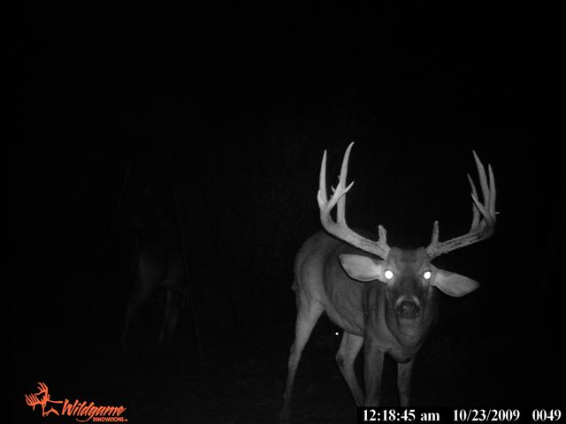
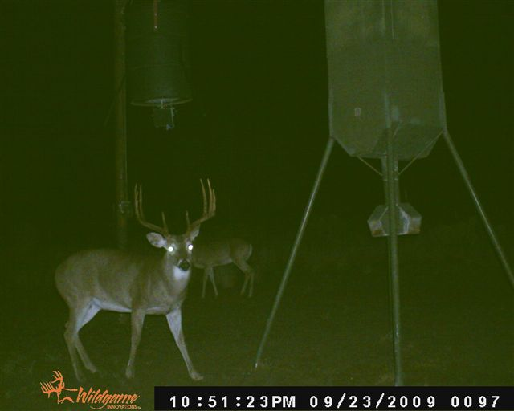
The Caiman Ranch will
not be on the market
long with this quality
trophy deer!

Slide 17
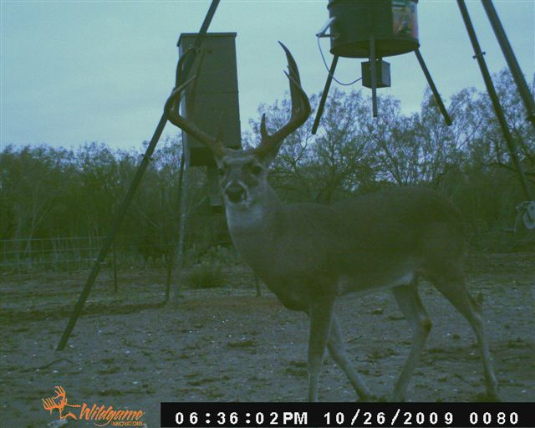
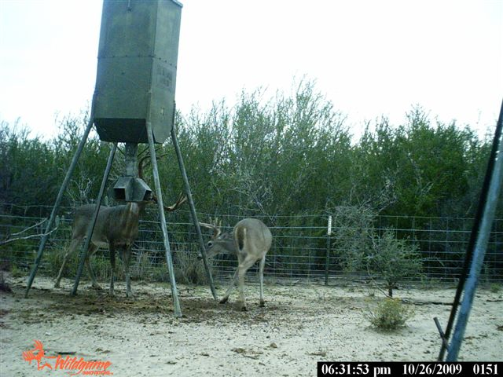
The Caiman produces
some of the best top
Texas Big Game Award
bucks every year.
Along with winning
other deer contests,
including Los Cazadores,
The Muy Grande, &
Cola Blanca.

Slide 18
For further information or for an appointment
to see the Caiman Ranch, contact:
GARDNER RANCH SALES, LLC
Derry T. Gardner, Agent
10 Ledge Lane
San Antonio, Texas
210-737-1321
210-288-4492 (mobile)
www.gardnerranchsales.com
SALES PRICE:
$5,000,000.00 OR $2,500.00 per acre
(surface estate only)
All photographs in this brochure were taken on the Caiman Ranch.
The information on this property is presented subject to errors, omissions,
change of price or conditions, prior sale, or withdrawal without
notice. Further, the information on this property is provided without
any guarantee, warranty, or representation, express or implied.

