Slide 1
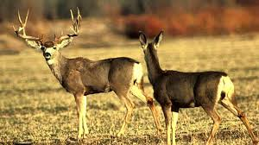
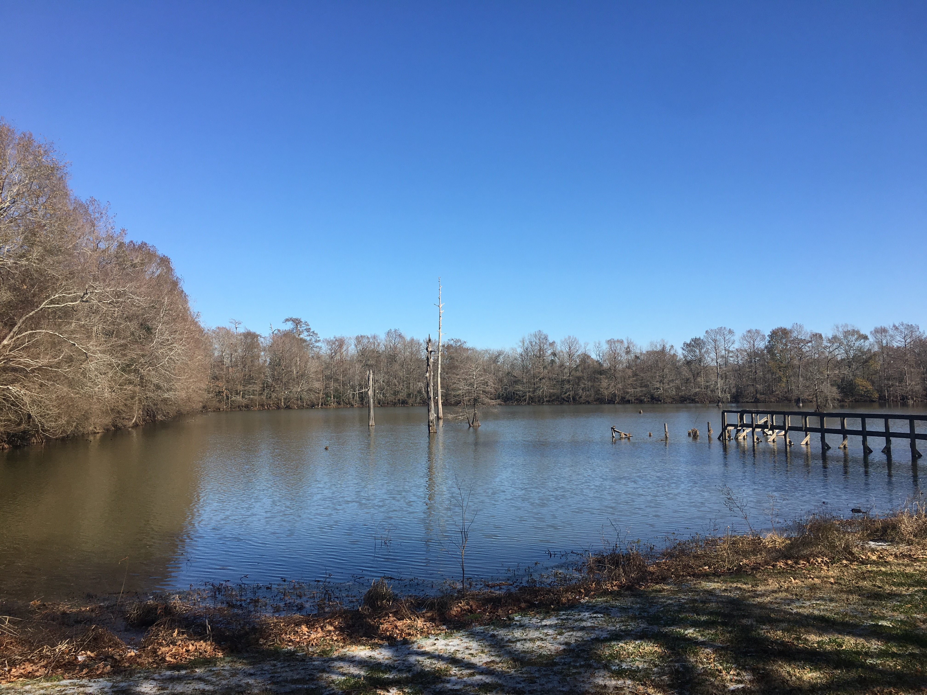
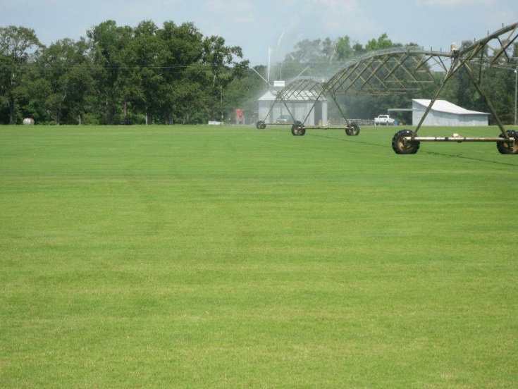

682 Maraist Rd
754 Acres
Crowley , Louisiana

Slide 2

Abundant
Hunting
Opportunities

Slide 3
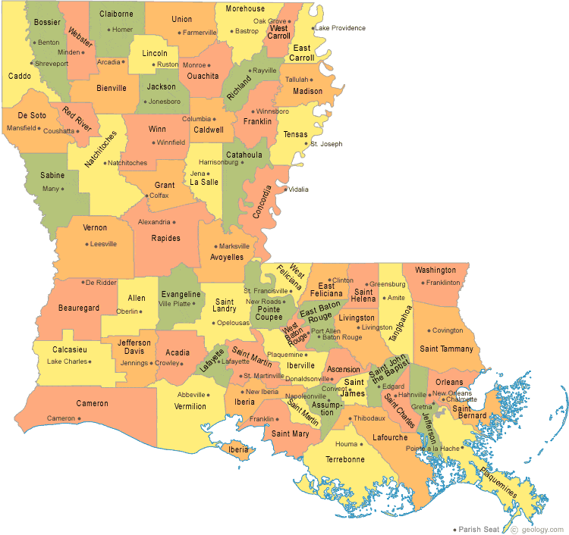
Approximately
2 Miles south of I-10
Crowley, La

Slide 4
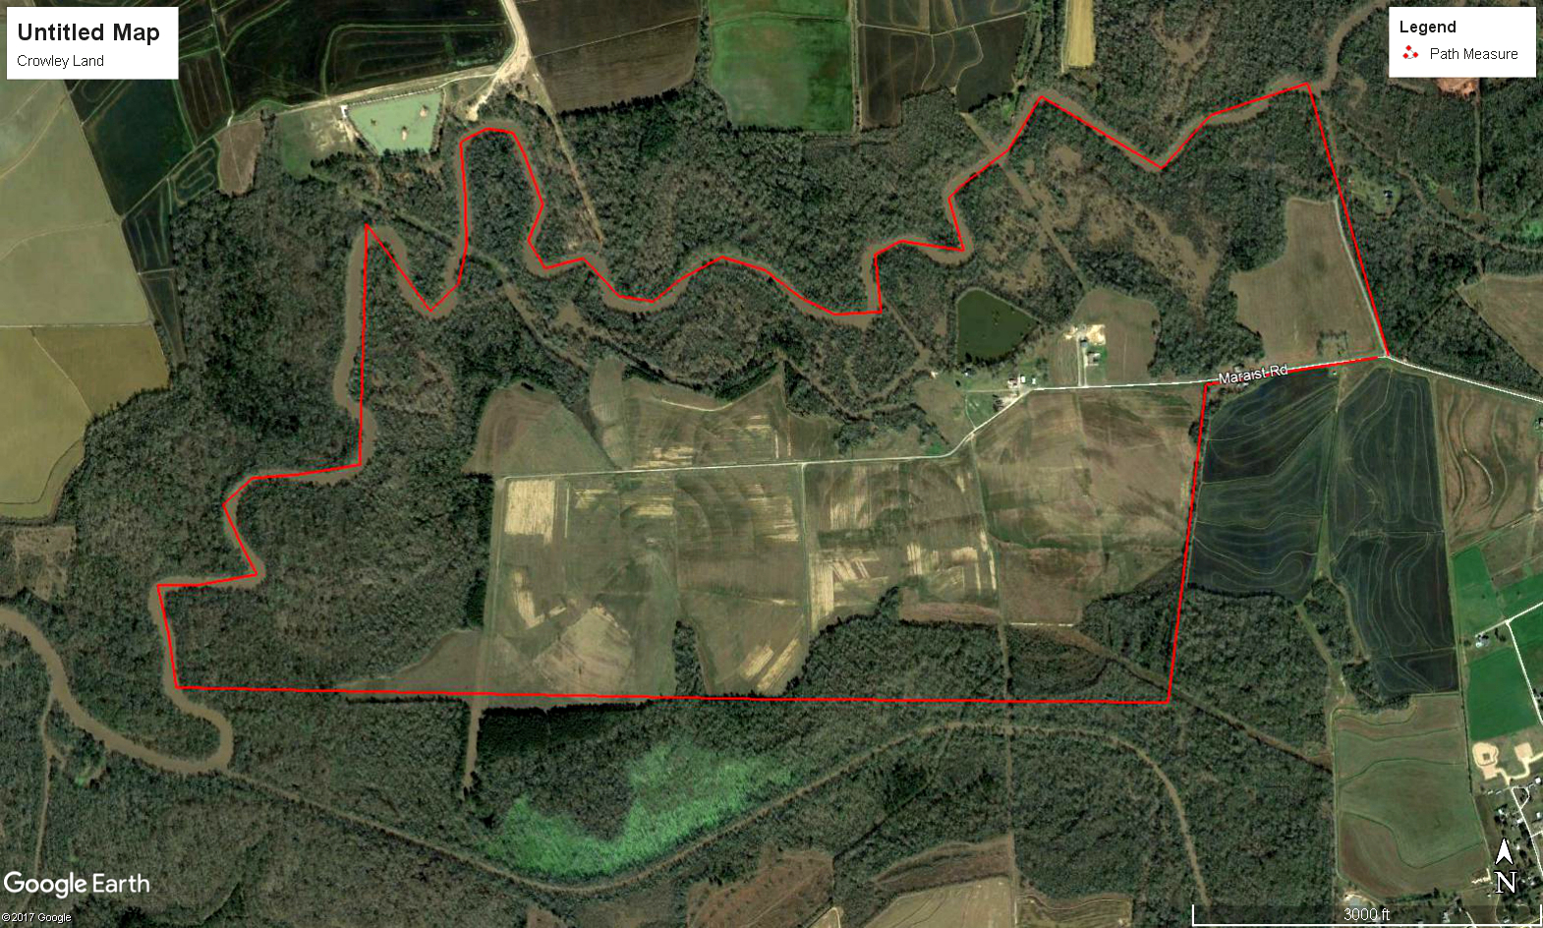
754 Acres

Slide 5
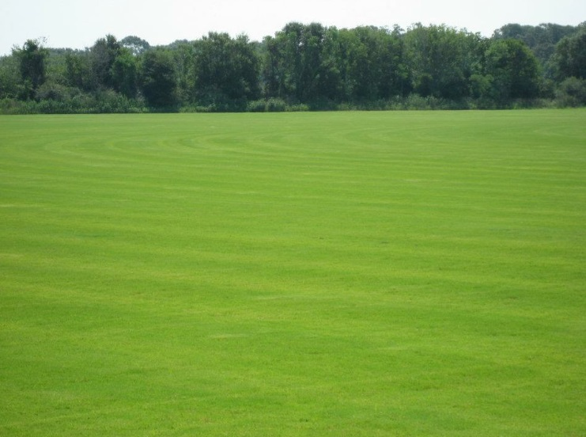
Precision Graded Land

Slide 6
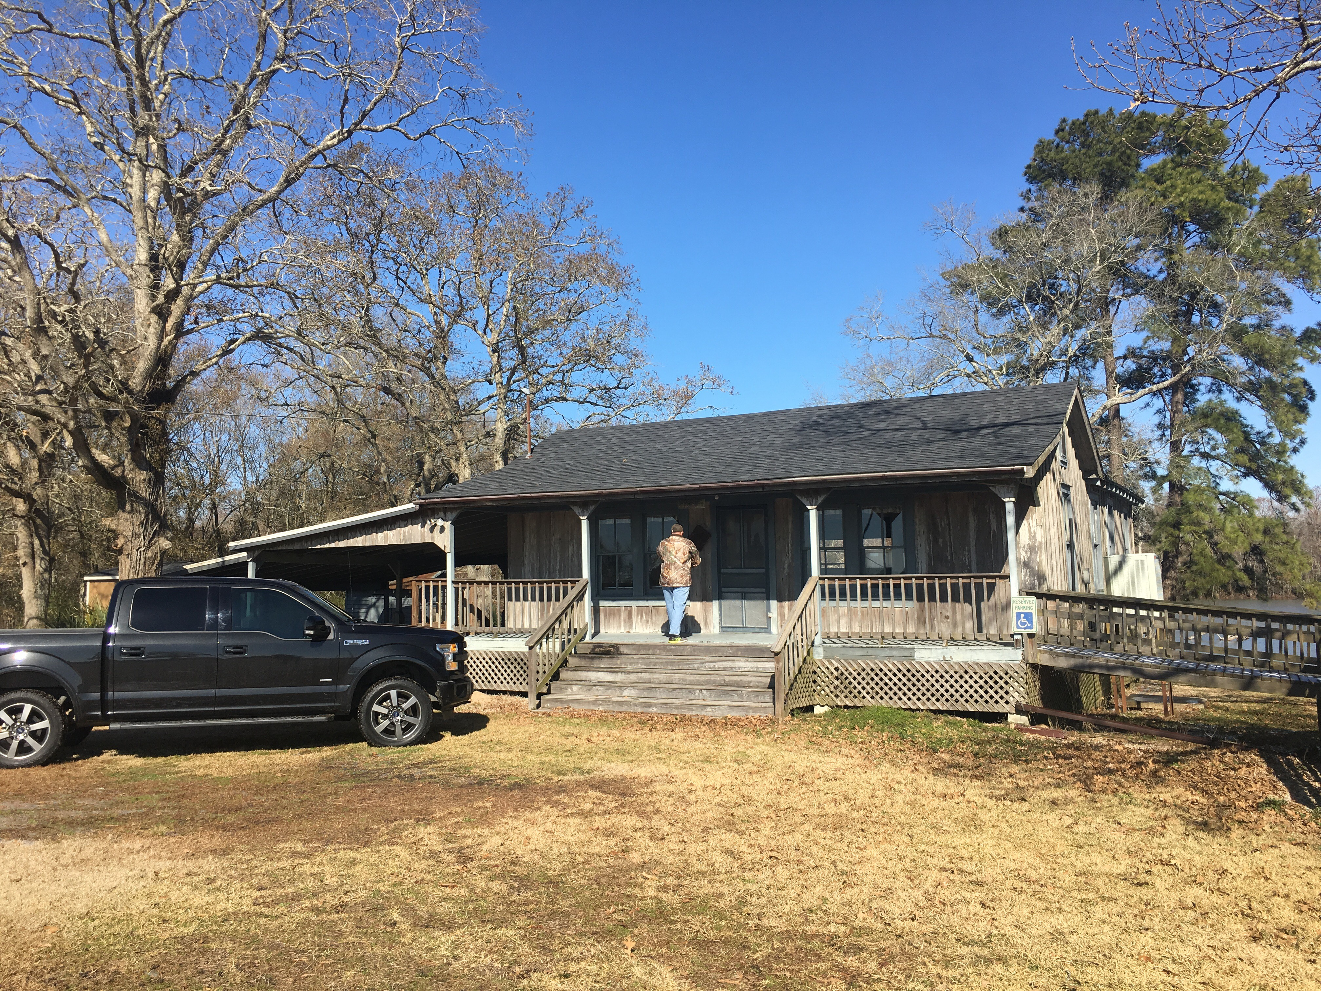
Camp

Slide 7
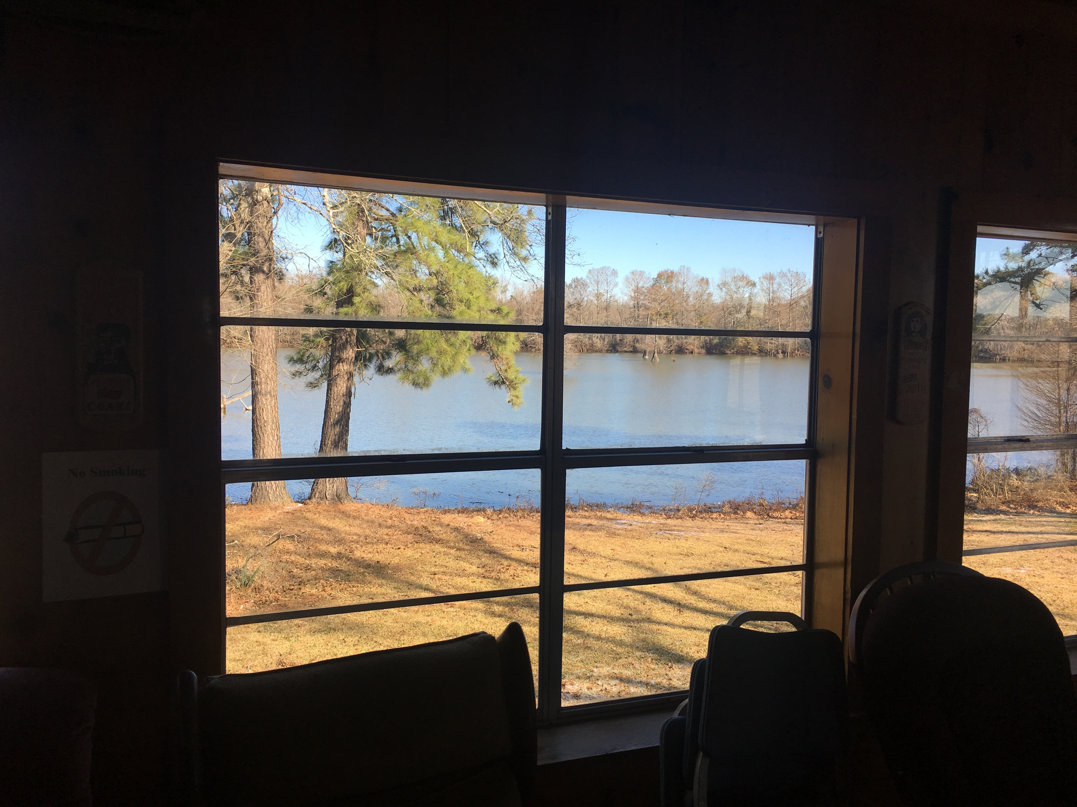
2100 Sq Foot Camp

Slide 8
12 Acre Stocked Lake

Slide 9
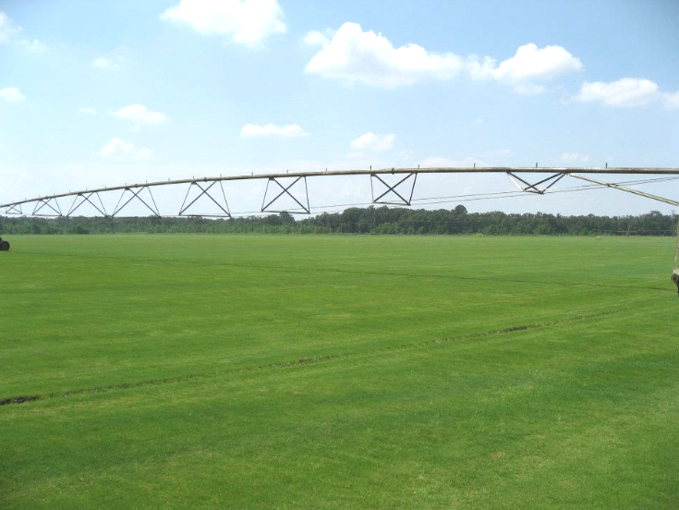
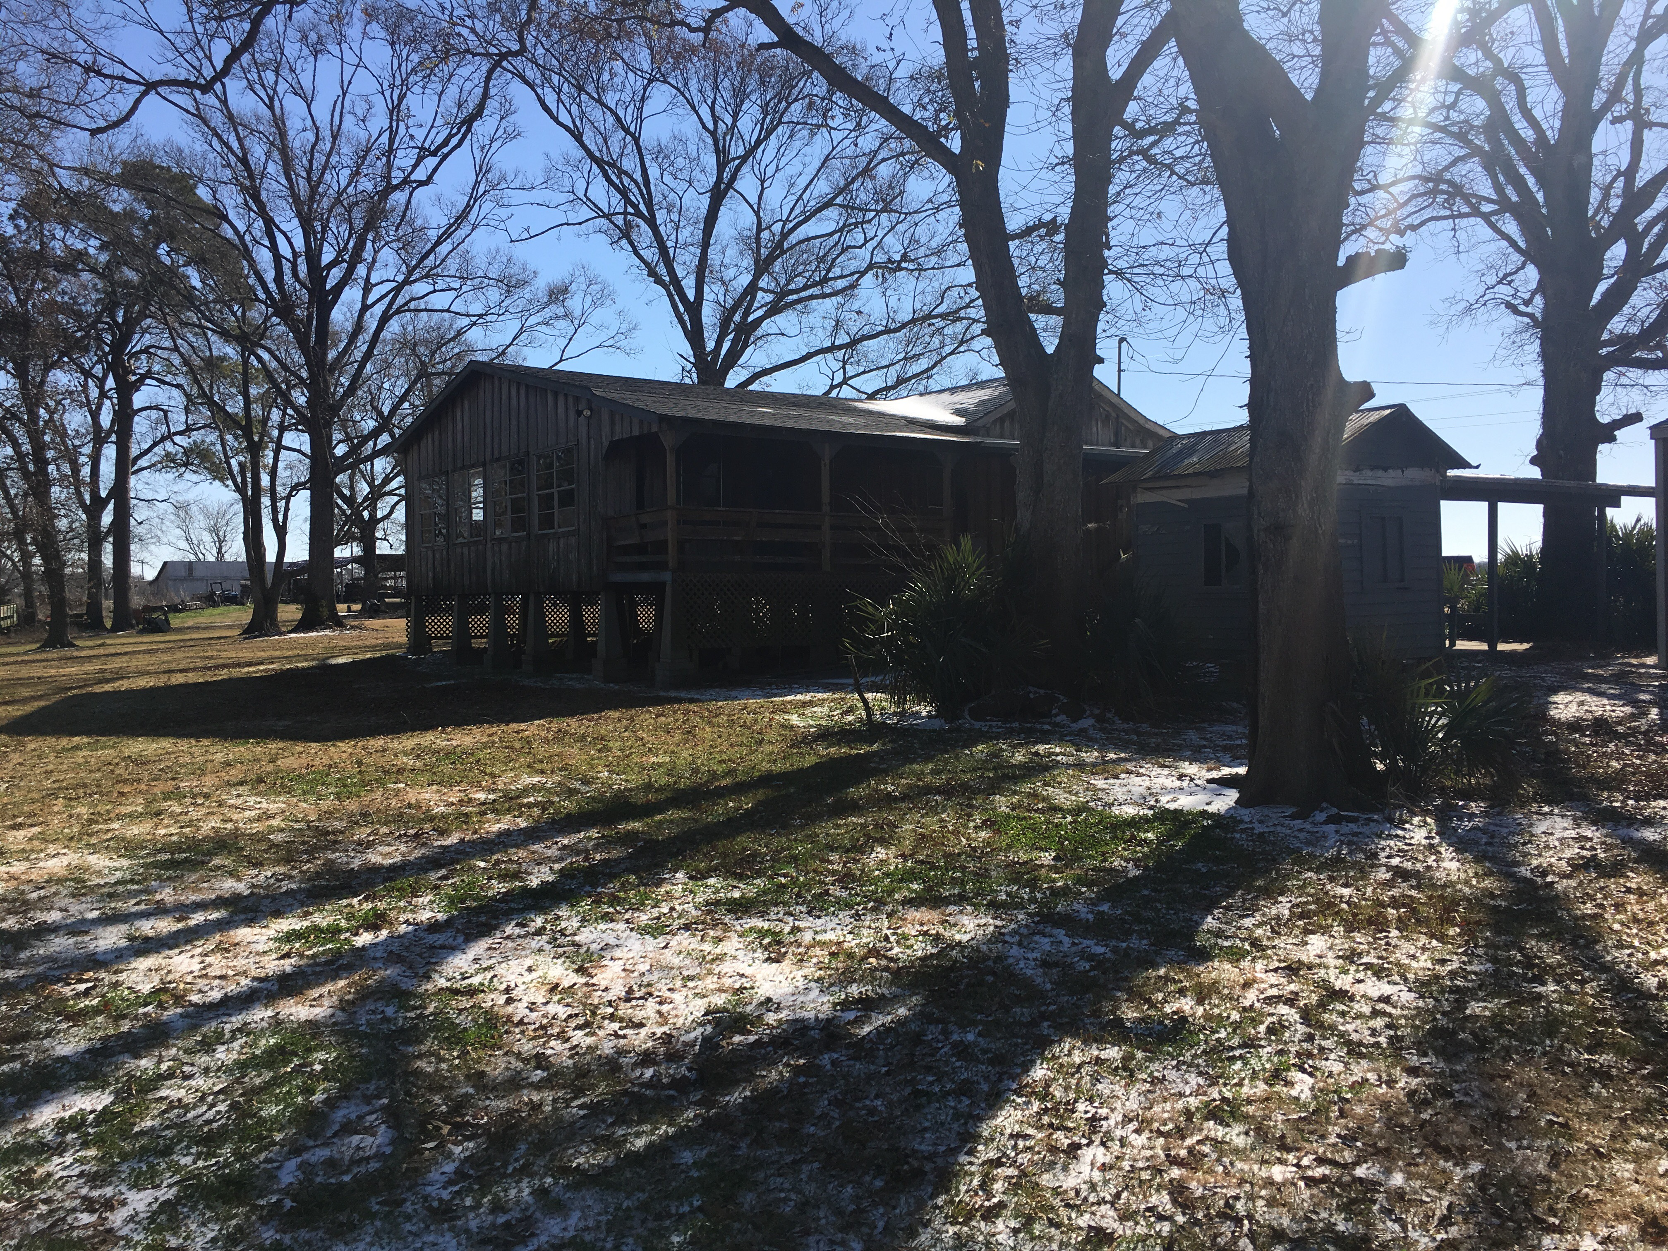
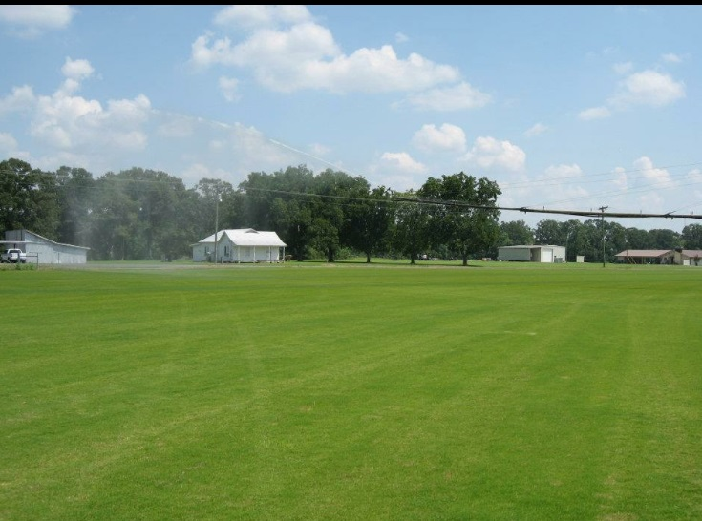
Precision graded Land
330 Acres Irrigated
424 Wooded Acres
Storage Buildings

Slide 10
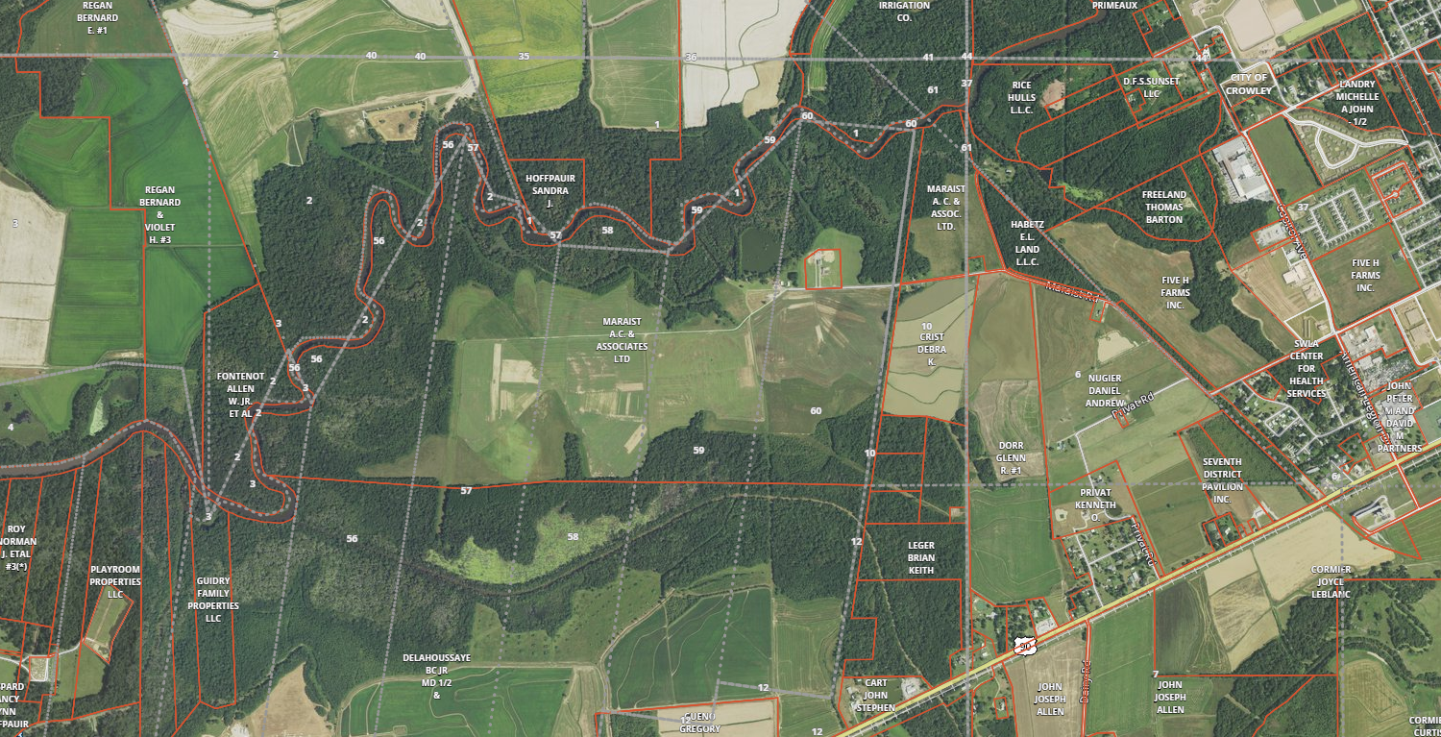

Slide 11
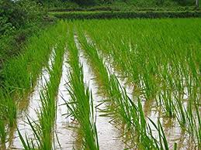
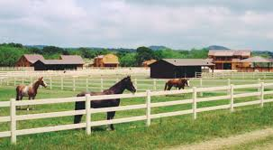
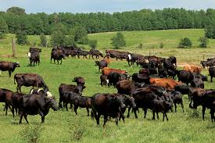
Possibilities for this Property
Rice Farming
Horses
Cattle

Slide 12
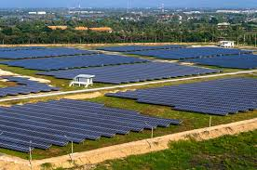
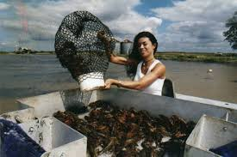
Other Possibilities
Crawfish Farm
Solar Farming

Slide 13

$3,448 per Acre
Asking Price $2,600,000
Land only, No Equipment or crop
Contact Ron Gaubert
(337) 280-2550

