Slide 1
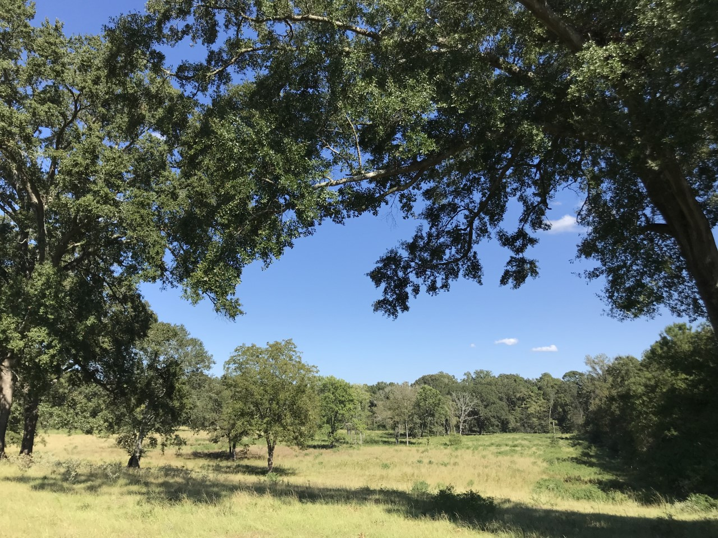
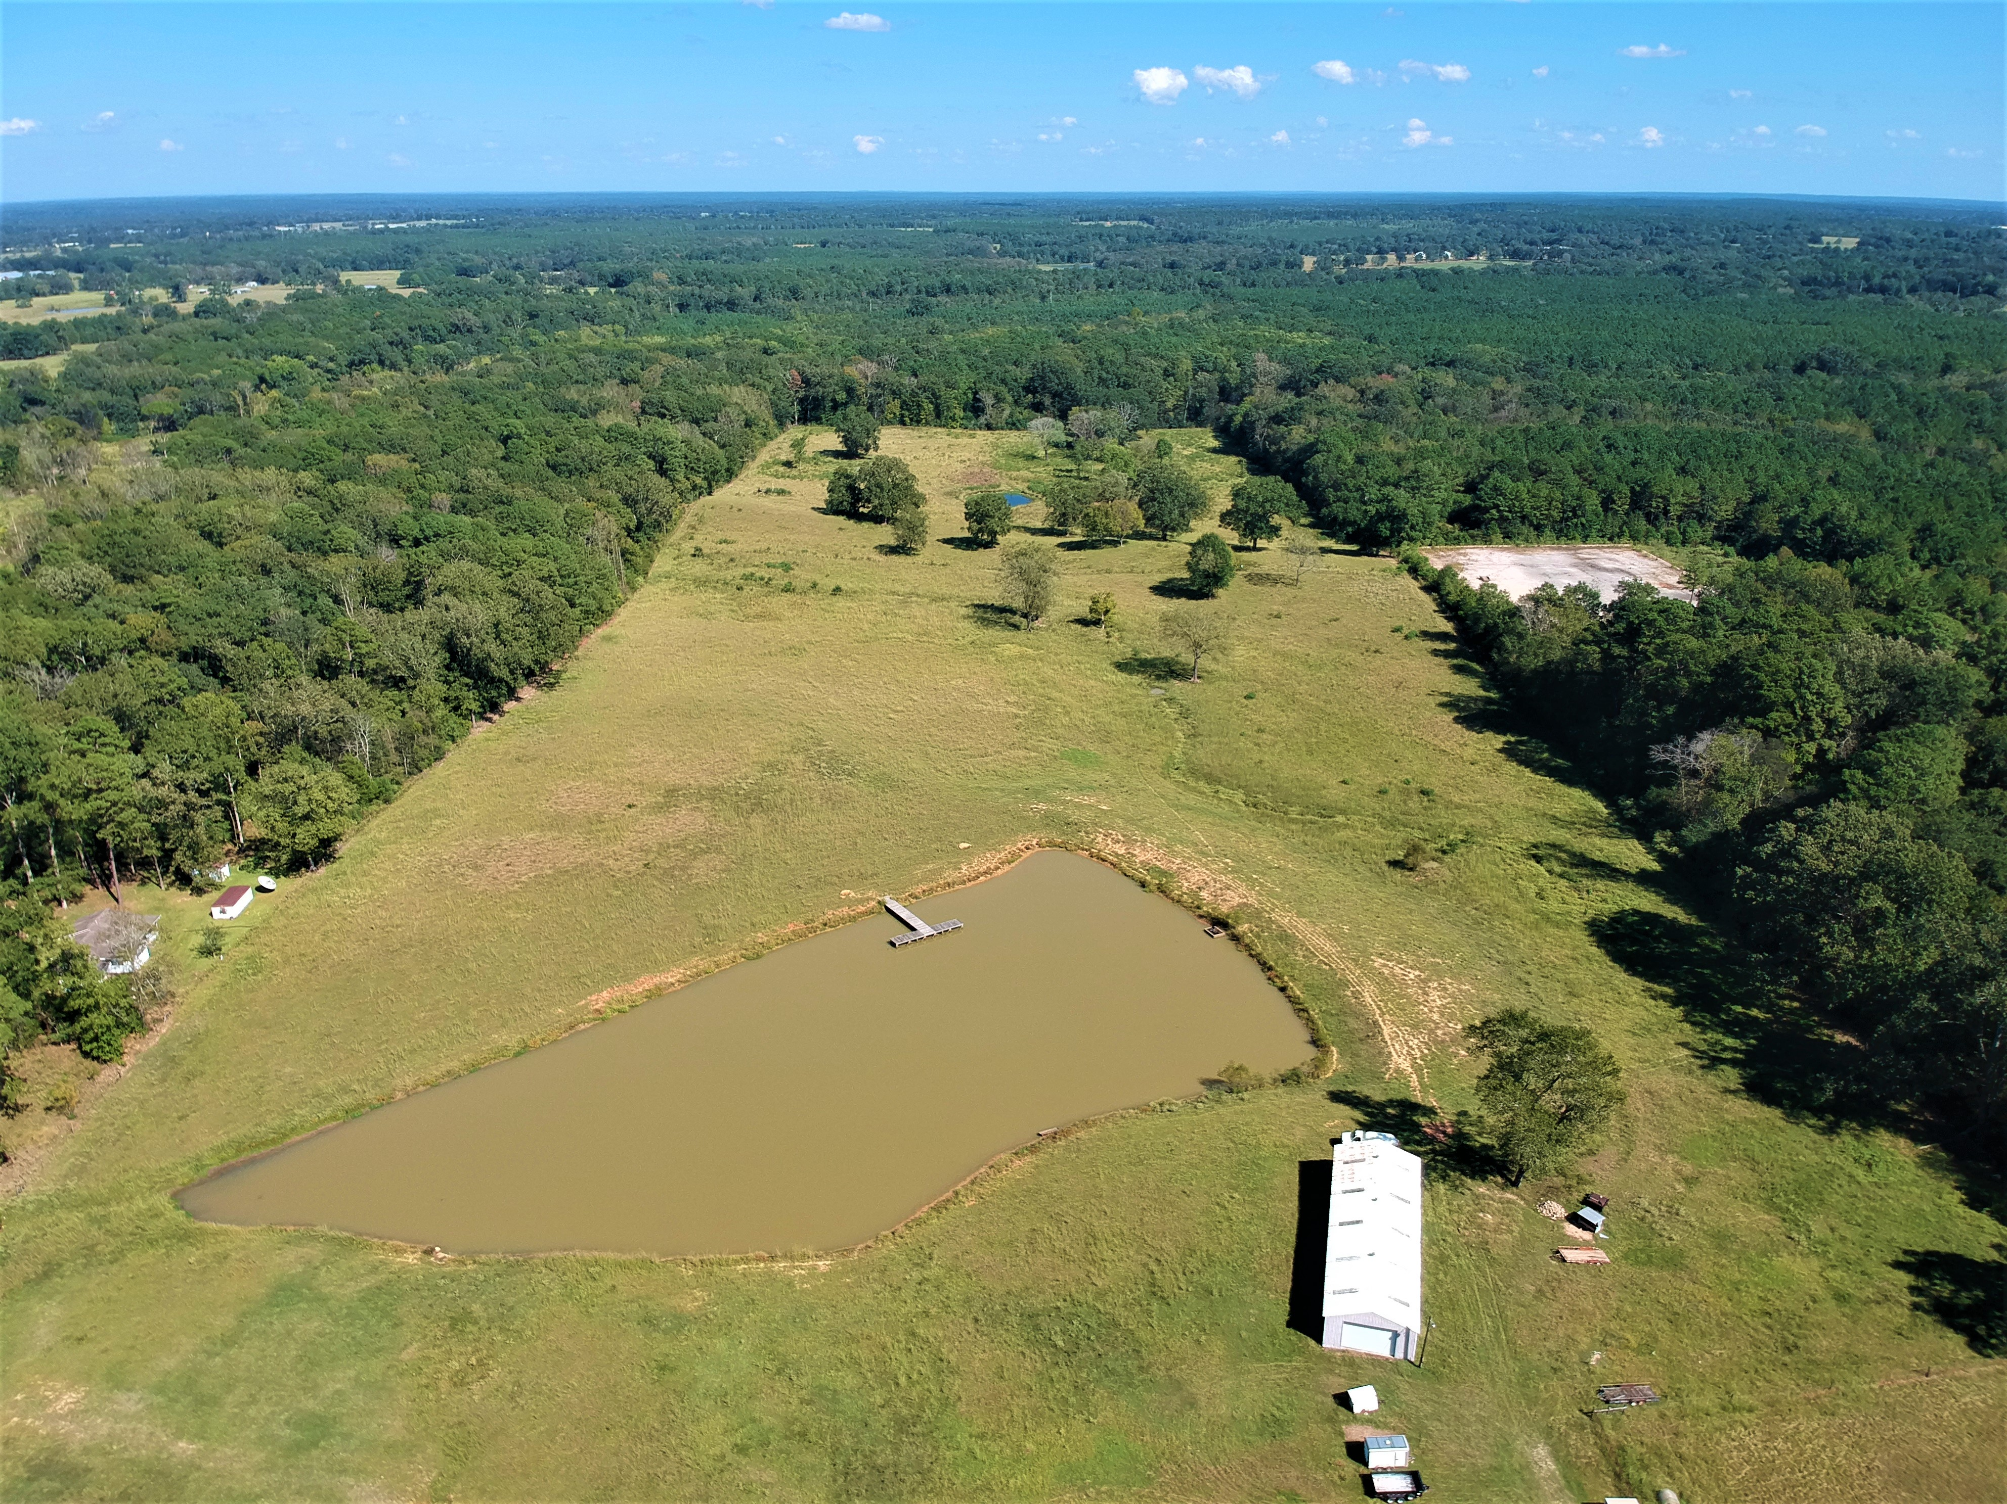
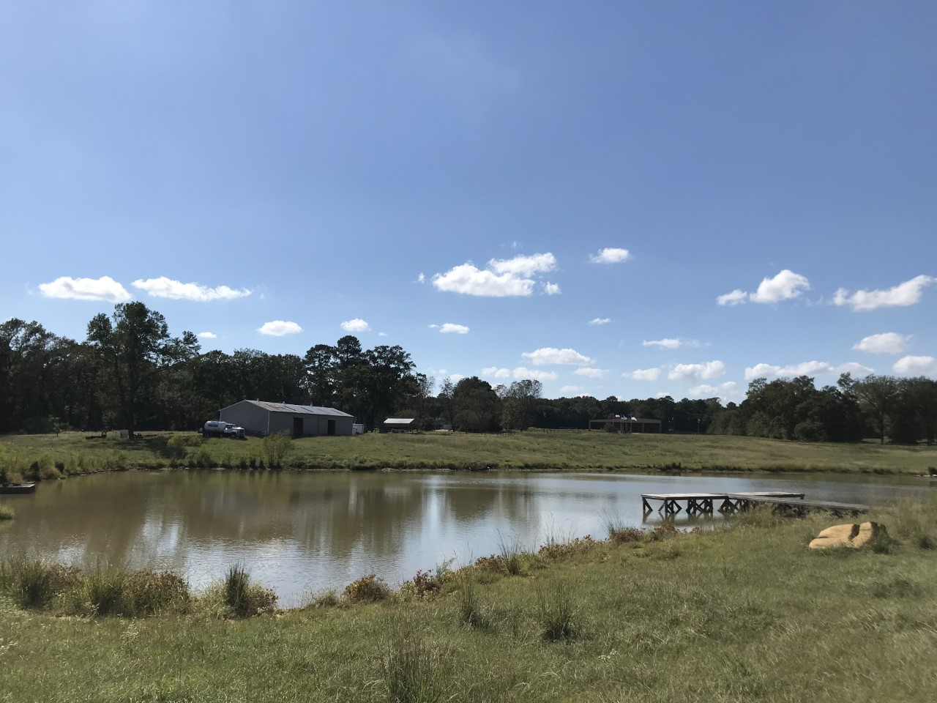




$325,000
2440 US Hwy 96 N in Center Texas
Premier Property!
Amazing Location! Gorgeous 46.9 acre property with multiple locations for a beautiful homesite. Rolling hills. Great views. Front pond has a pier. Minutes from downtown, yet out of city limits. High end fencing and cross fencing. Area near highway has electric/
water/septic and is set up to use well water or coop water. Building on site has concrete floor in part of it. One of a kind!
Listing agent: Jane Blount
214-250-4119

