Slide 1
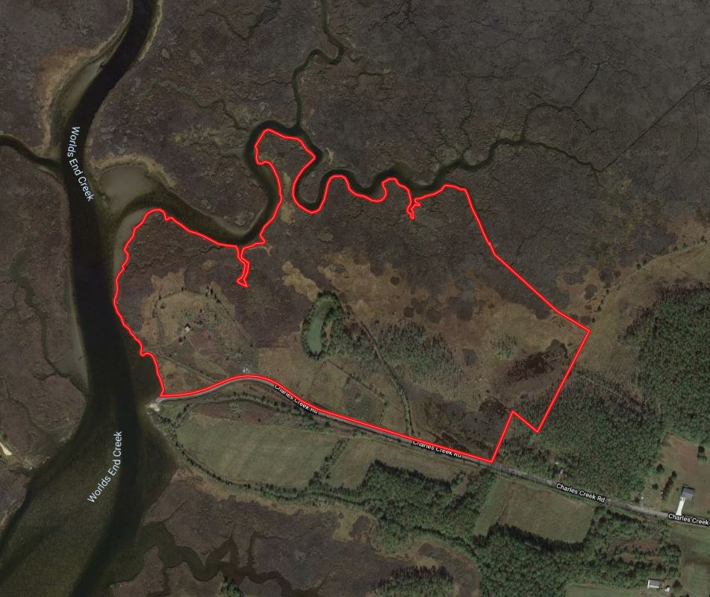
Hopkins Farm
Ben Alder
Nick Campanaro
ben@thelandgroup.us
nick@thelandgroup.us
443-865-1344
443-465-3520

Slide 2
Charles Creek Road | Church Creek, MD
52
Dorchester
$219,000
+/- 52 marshland acres with significant water frontage along Worlds End Creek in Crapo, MD. Property is mostly upland marsh with some woods and a freshwater pond. Improvements include a small outbuilding and boat ramp. Good road system throughout. Not your typical Dorchester County marshland.
Ben Alder
Nick Campanaro
ben@thelandgroup.us
nick@thelandgroup.us
443-865-1344
443-465-3520

