Slide 1
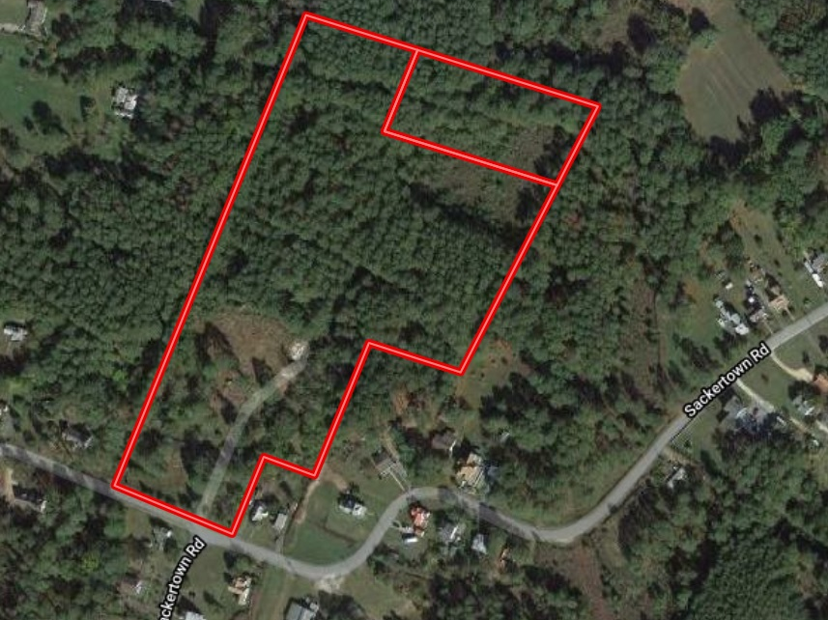
Stouty Sterling Road Wooded Homesite
Crisfield, MD
Sue Hudson
sue@thelandgroup.us
410-774-0643

Slide 2
Sackertown Road Wooded Homesite | Crisfield, MD 21817
11.87+- wooded, secluded homesite in Crisfield, this property is perfectly suited for the outdoorsman or the person who wants to get away from it all. There is an existing well and septic from the original farmhouse. There are no conservation easements or other restrictions.
Total Land Value: $20,084 - $31,432
*Note – the existing well and septic adds value to the property above the land value
Recommended List Price: $40,000

